Slide 1


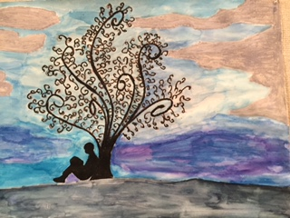

Heatherwood Middle School
State of the School Review
February 26, 2016

Slide 2
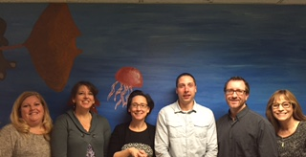
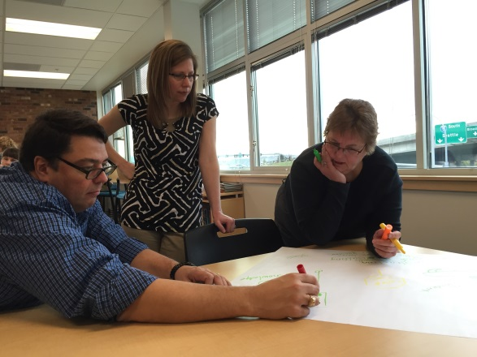

Heatherwood’s Team
Chris Allen & Juli Taylor: 6th Grade English
Dianne Lundberg: 7th Grade English
Jesse Swarthout: 8th Grade English
Amanda Brandt: Math
Sue Wilson: Science
Tami Coffman: Unified Arts
Jeff Jones: Assistant Principal
Laura Phillips: Principal

Slide 3
Heatherwood’s Story
Change
Challenge
Opportunity

Slide 4
Change in Staff
Principal
Assistant Principal
Librarian
Science/Math & Technology
Lifetime Fitness

Slide 5
Programs & Systems
Challenging Options
Spanish
Semesters
Curriculum
Smarter Balance Assessment
Chrome Books
Lifetime Fitness Waivers
Orchestra?
24 Credits
TPEP

Slide 6
Heatherwood’s Story
Shifting Demographics
Increase in Students
Increase in discipline
Increase in students of poverty
Increase in English Language Learners

Slide 7
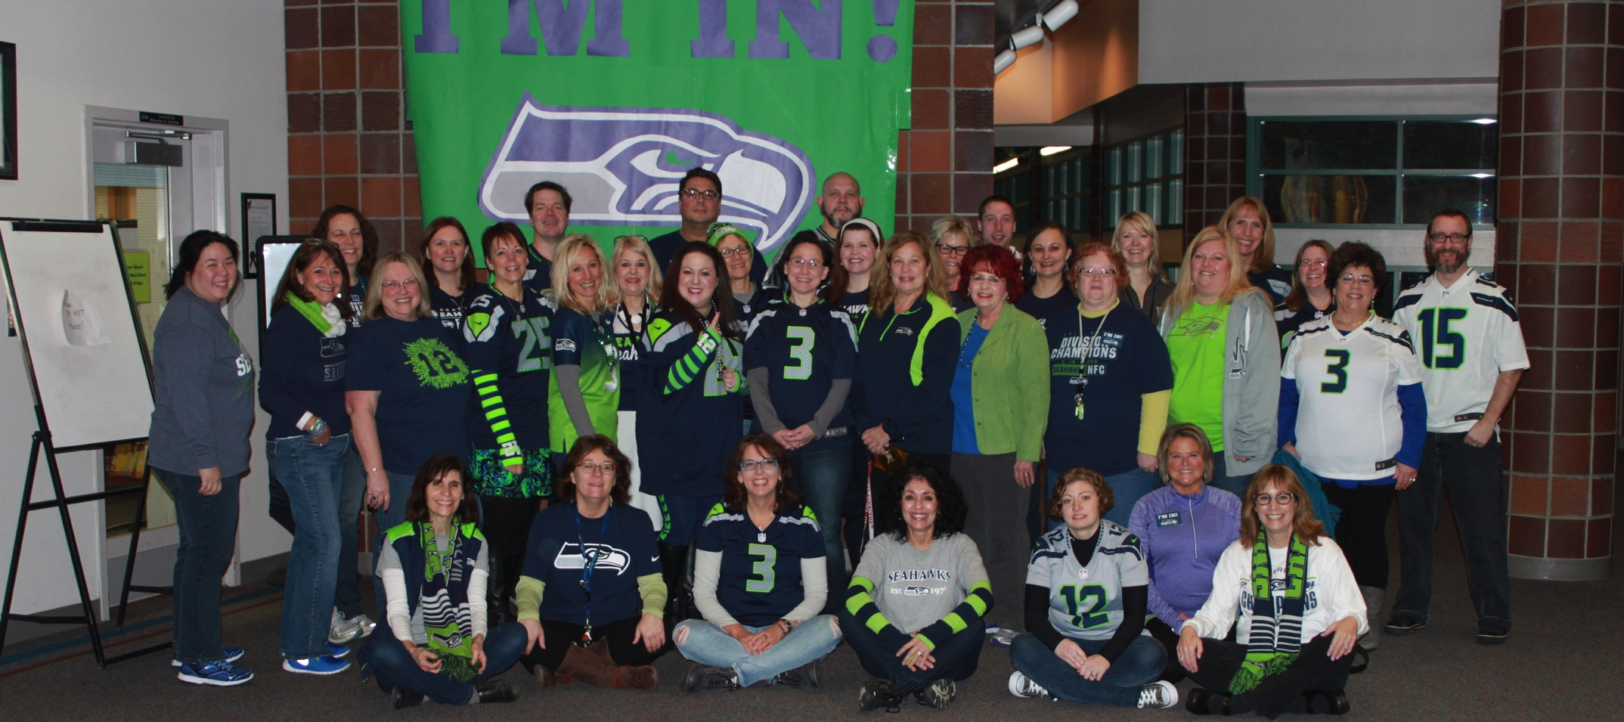
ALL IN for Students!

Slide 8
Demographic Trends
+115
+80
-10.5%
9.1%

Slide 9
Changing Demographics
53.8%

Slide 10
Middle School Counts
(Number of students assessed at each grade)
ELA
265
Math
261

Slide 11
Challenges
Low SES
High(er) Discipline
More absences
Achievement Gap

Slide 12
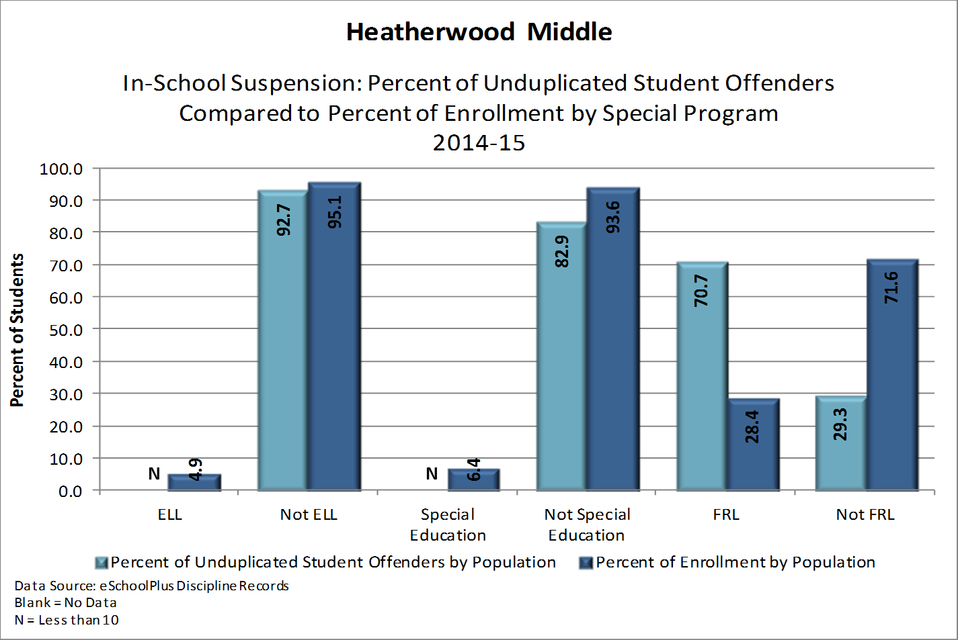
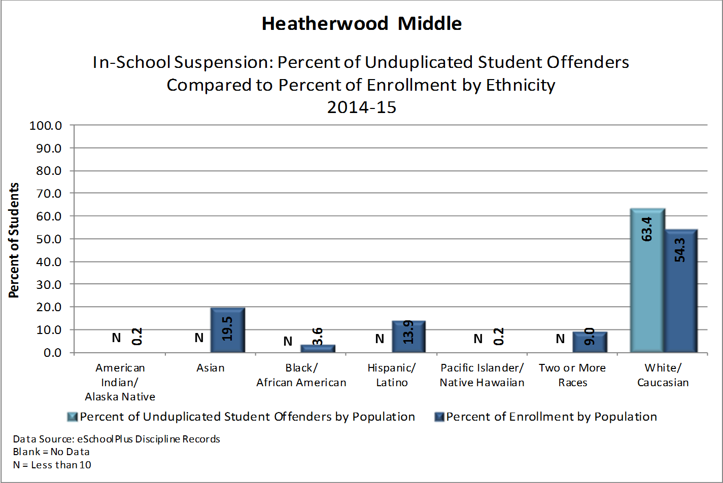
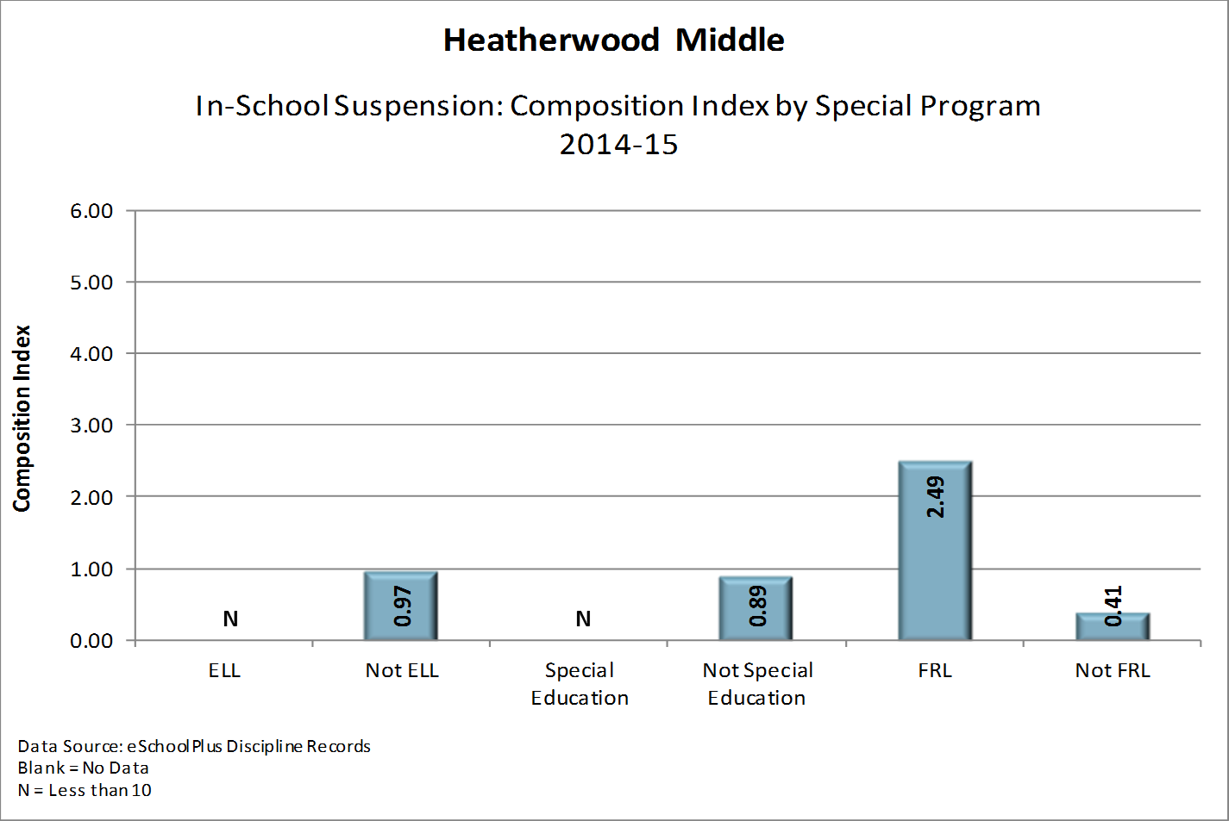
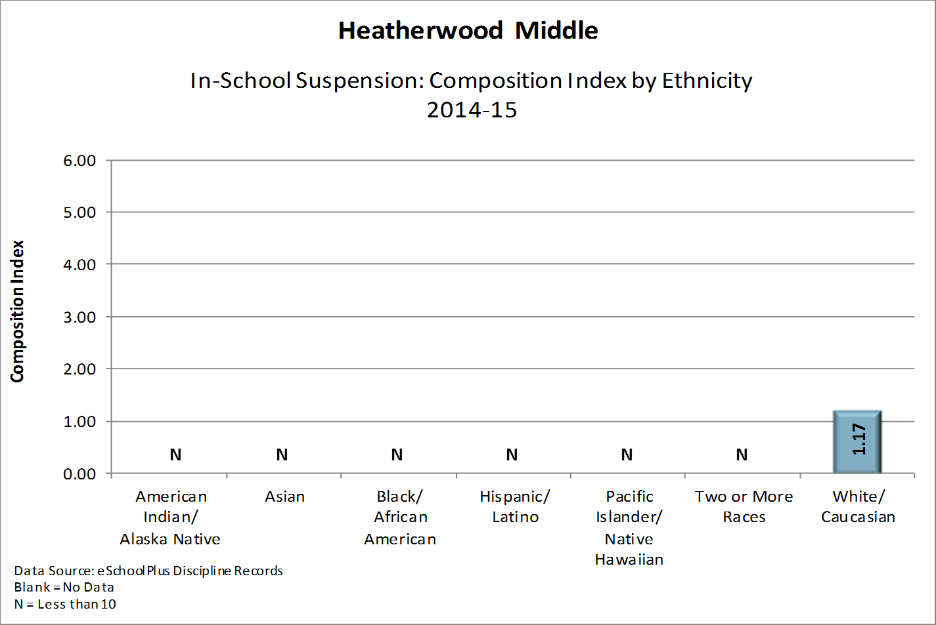
Discipline Data: In-School Suspension

Slide 13
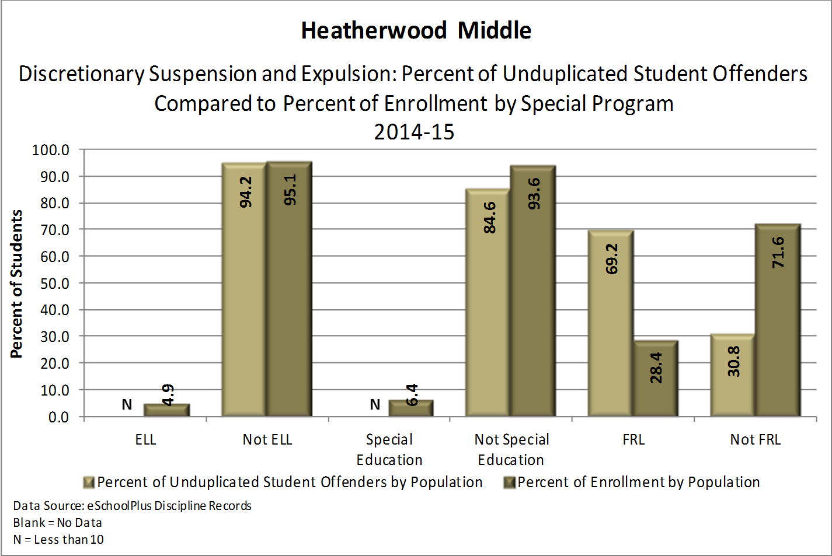
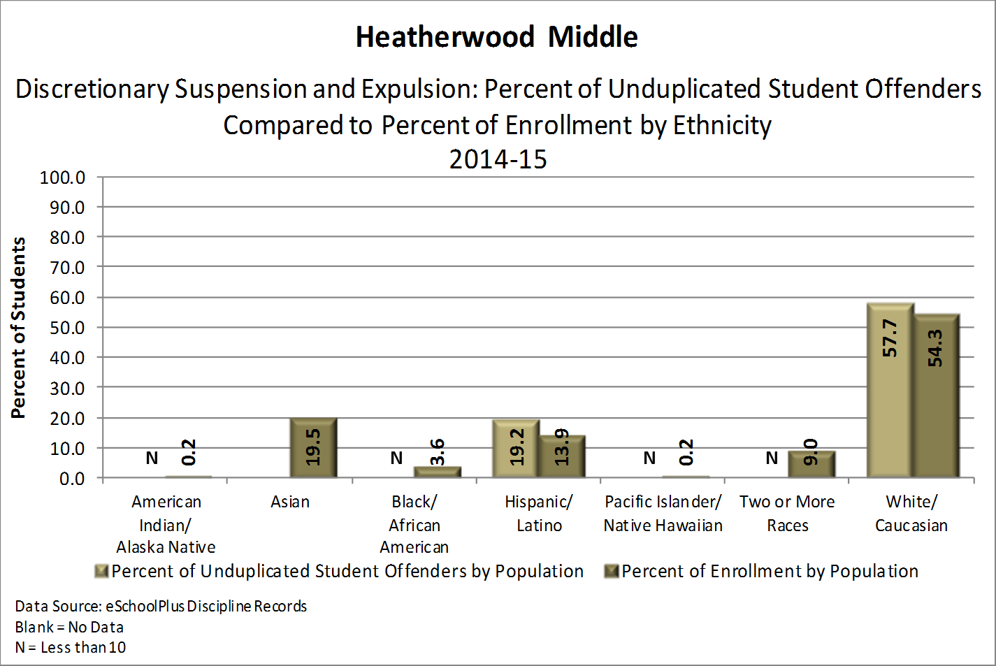
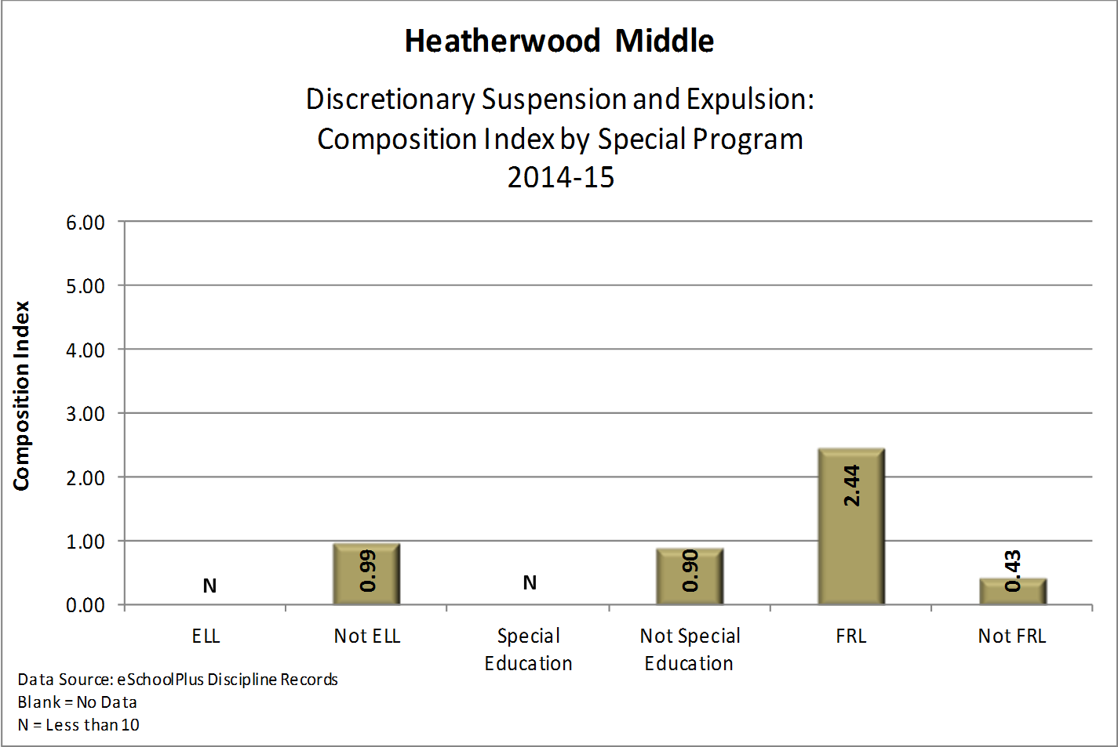
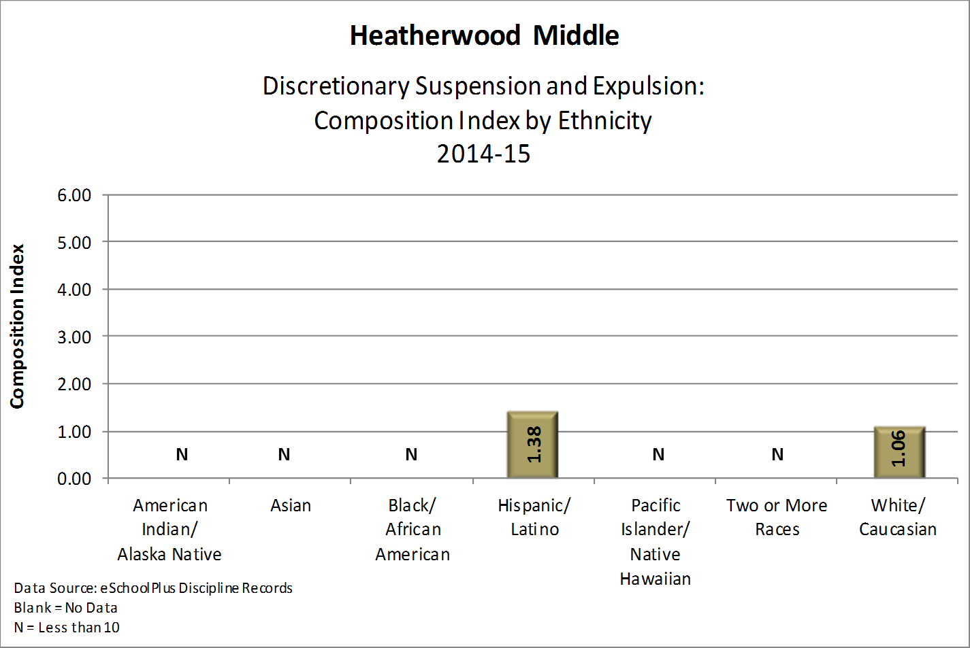
Discipline Data: Discretionary Suspension & Expulsion

Slide 14
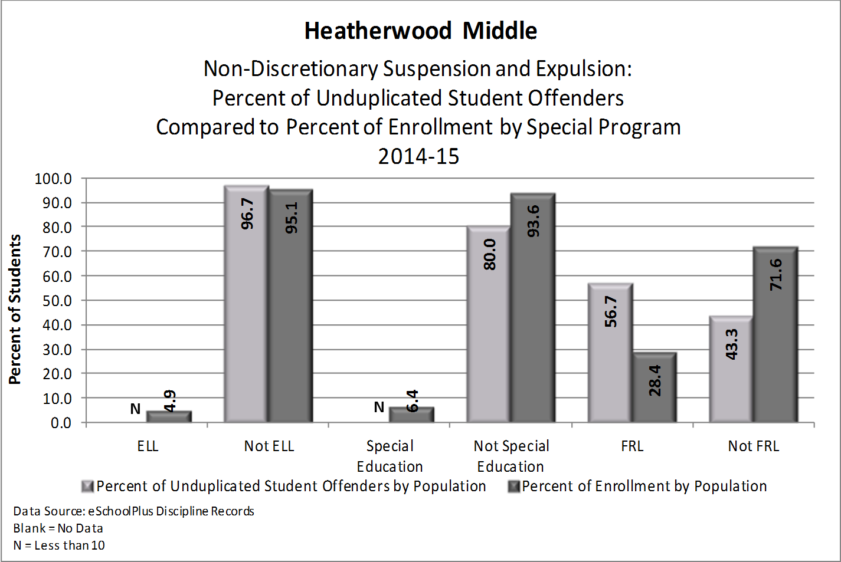
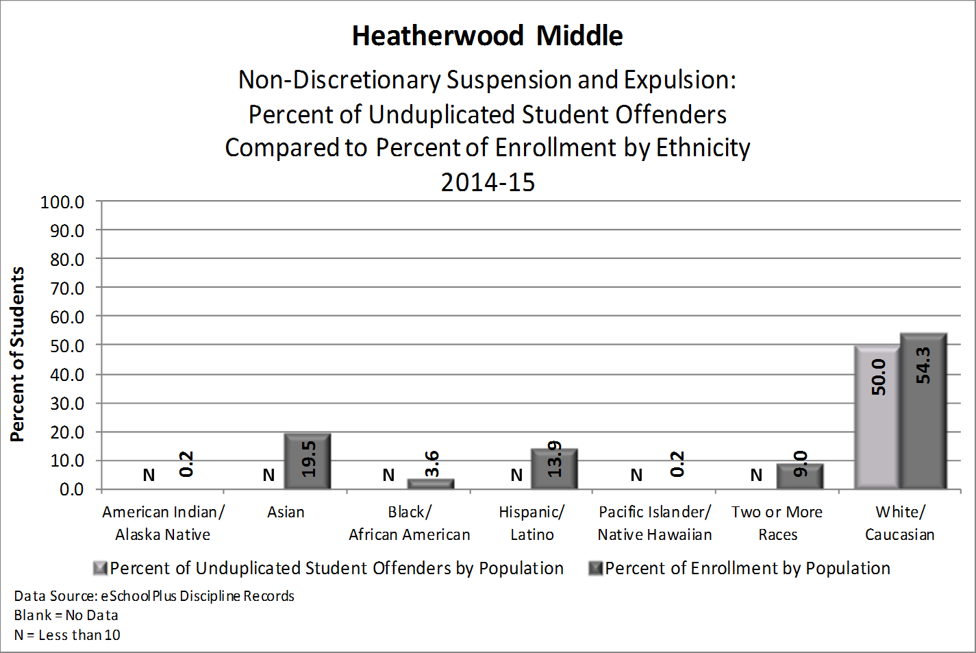
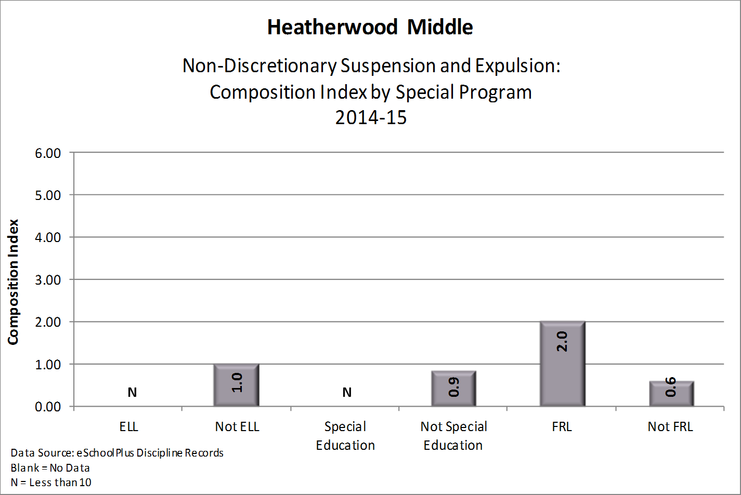
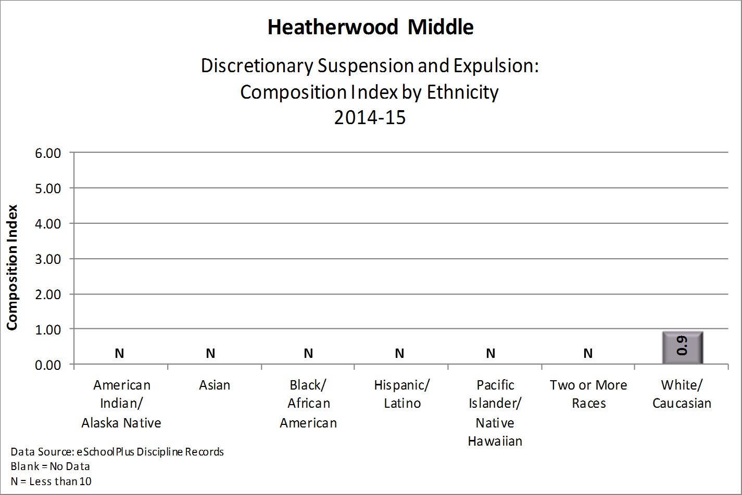
Discipline Data: Non-Discretionary
Suspension & Expulsion

Slide 15
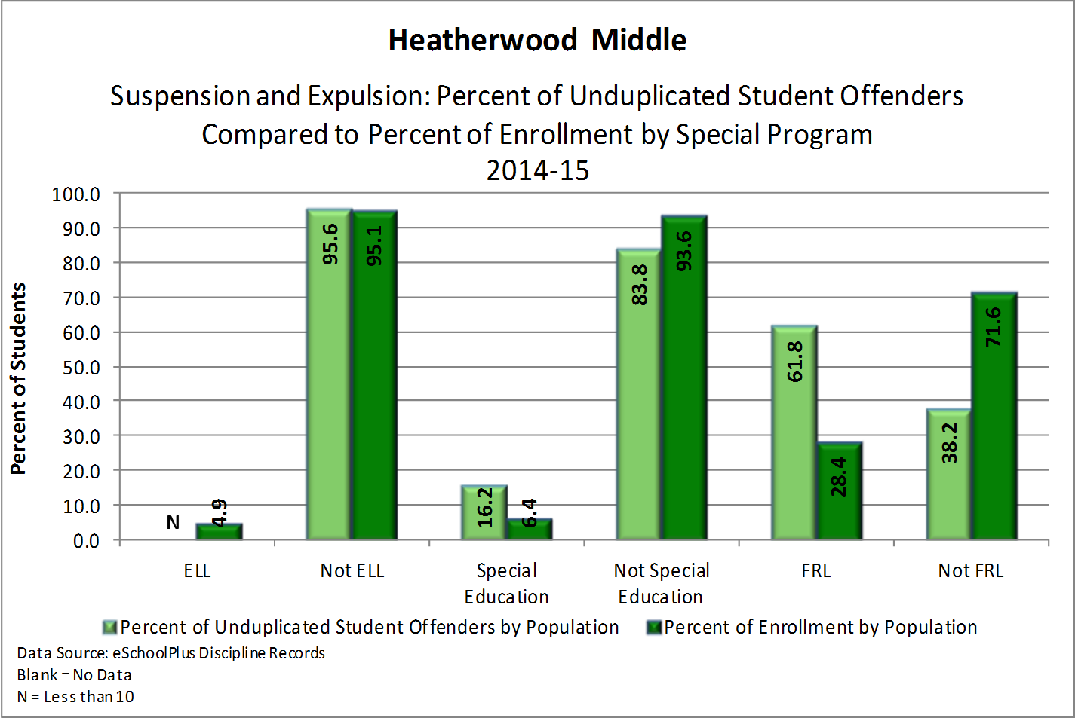
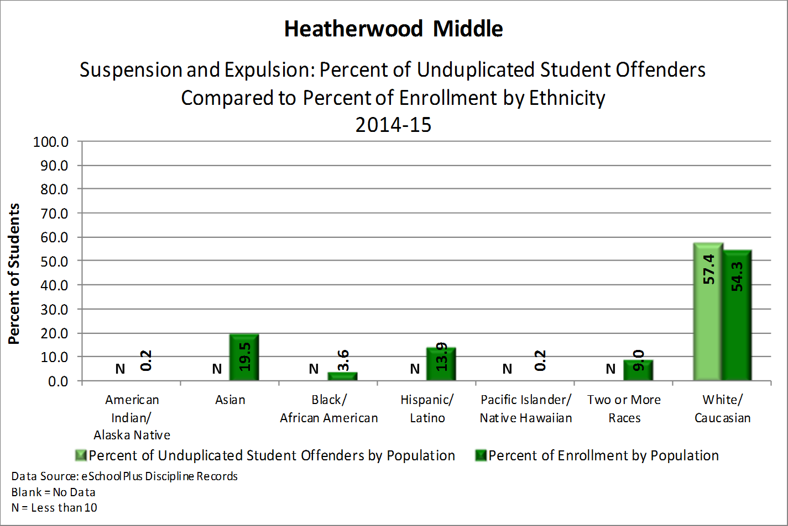
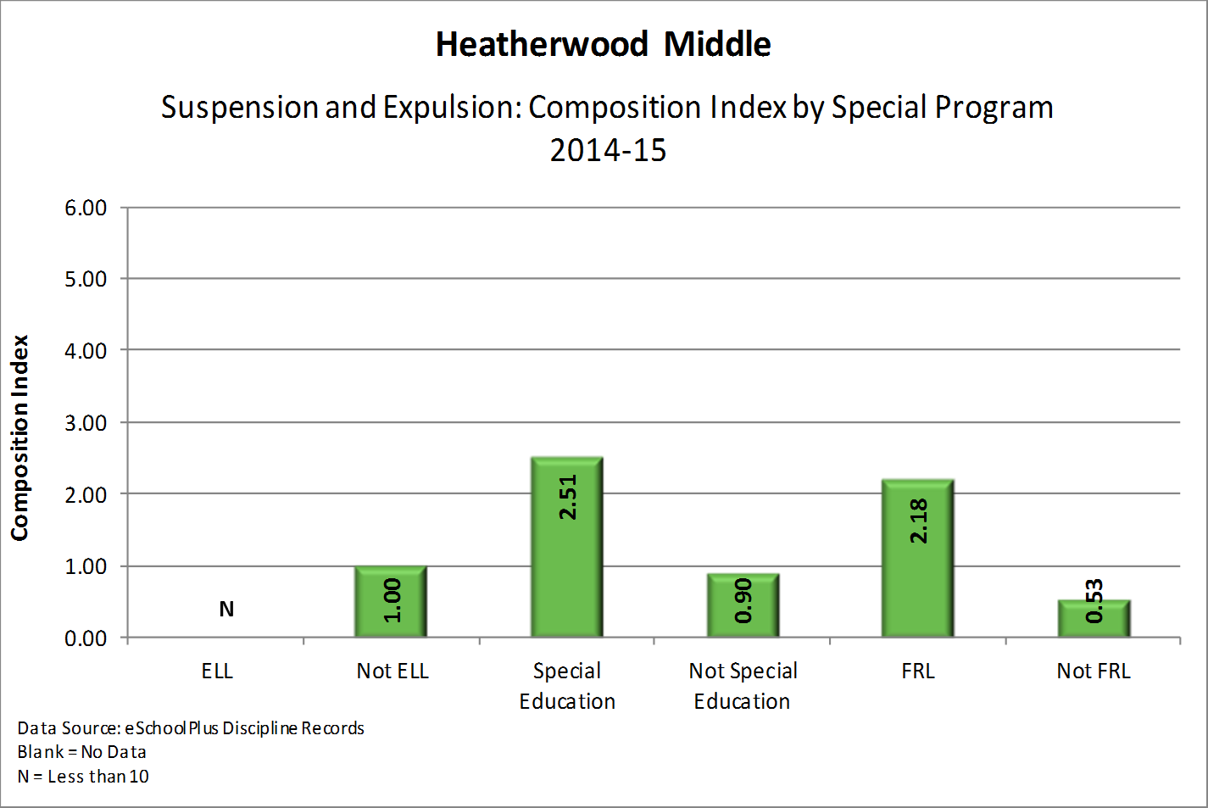
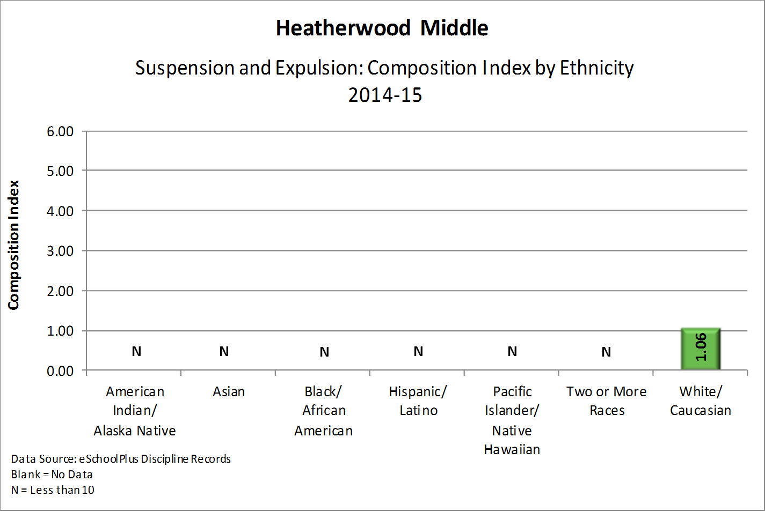
Discipline Data: Suspension & Expulsion

Slide 16
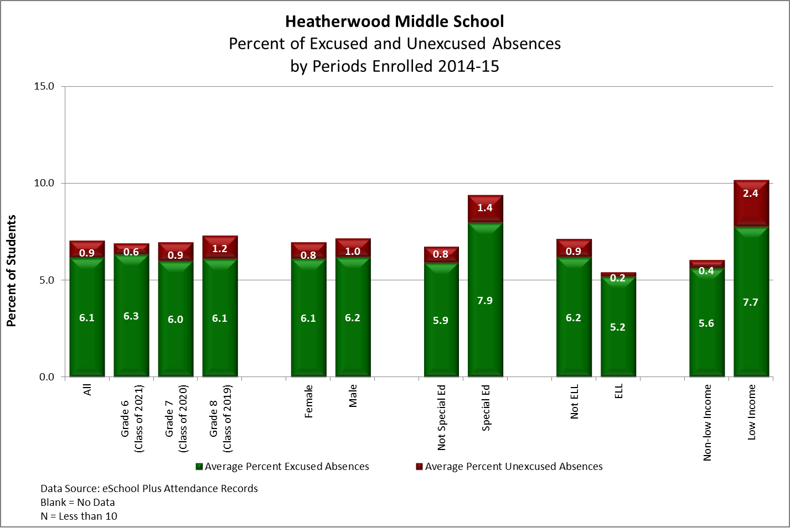
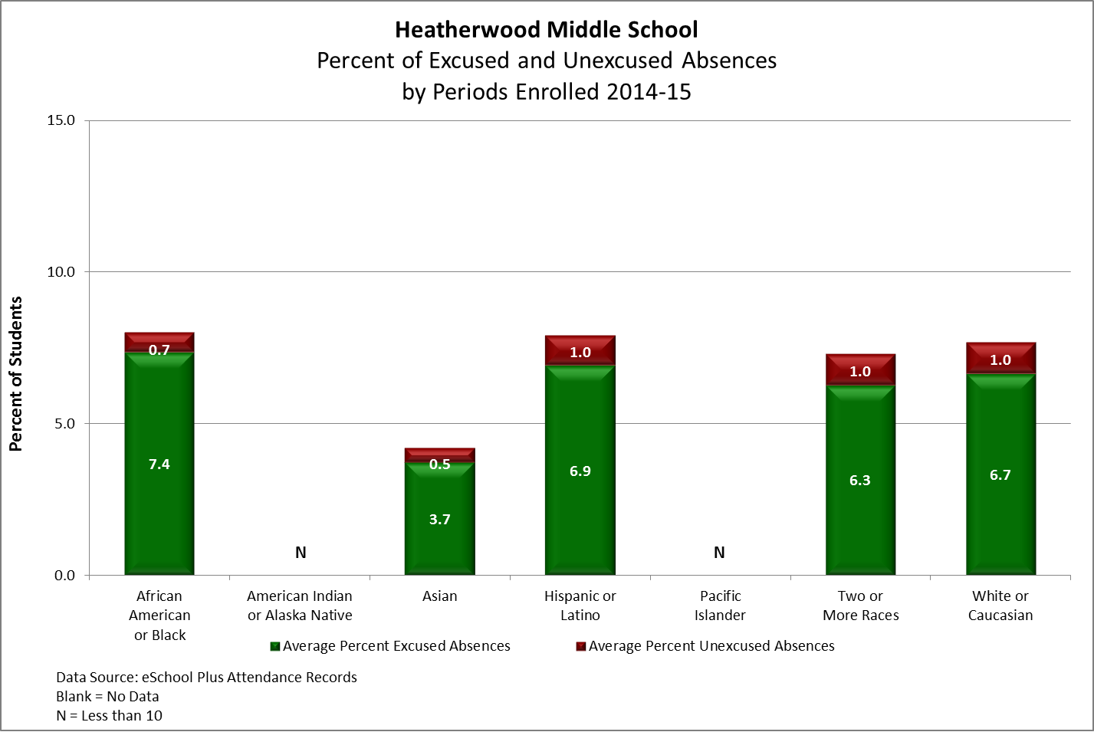
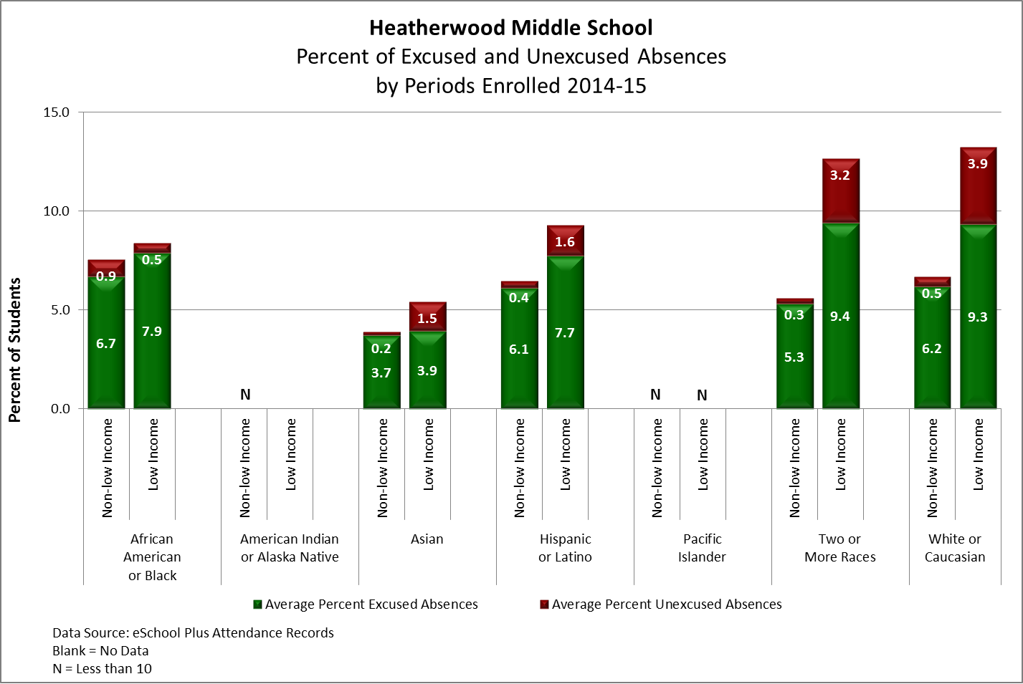
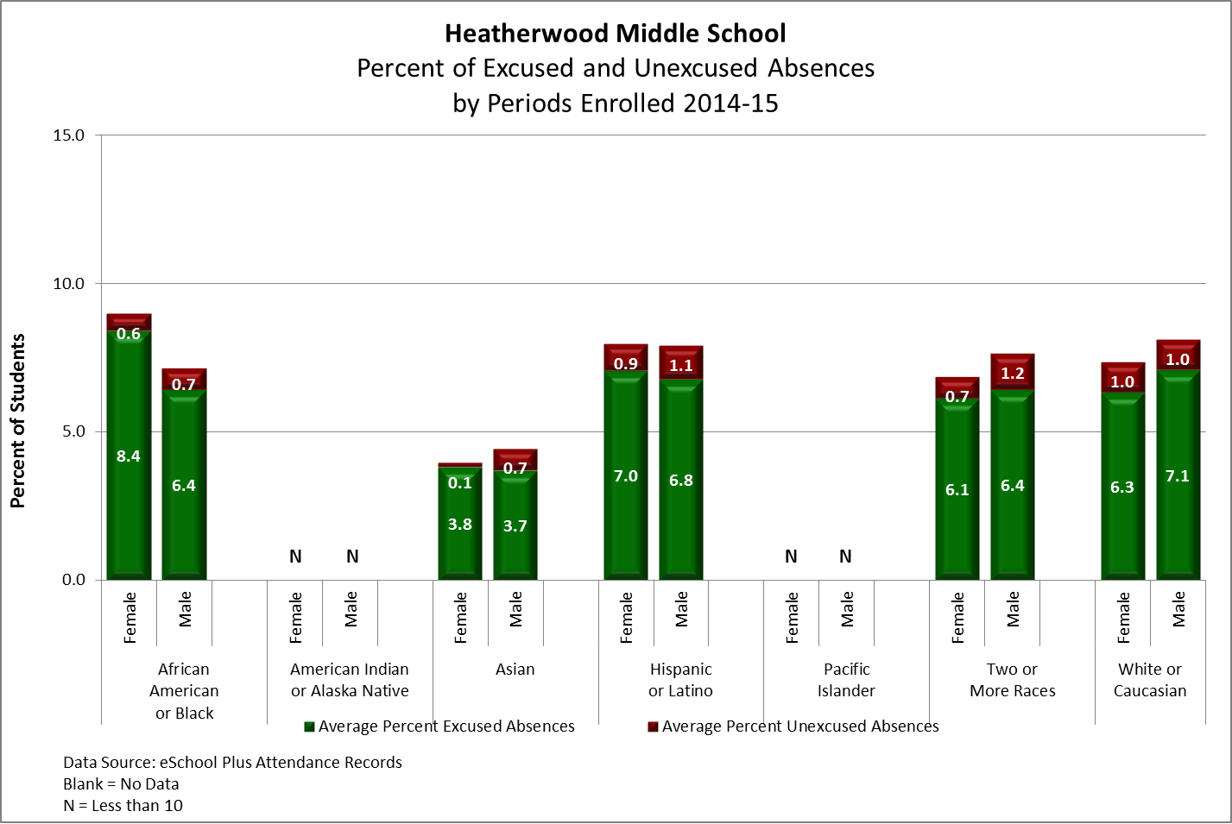
Attendance Data

Slide 17
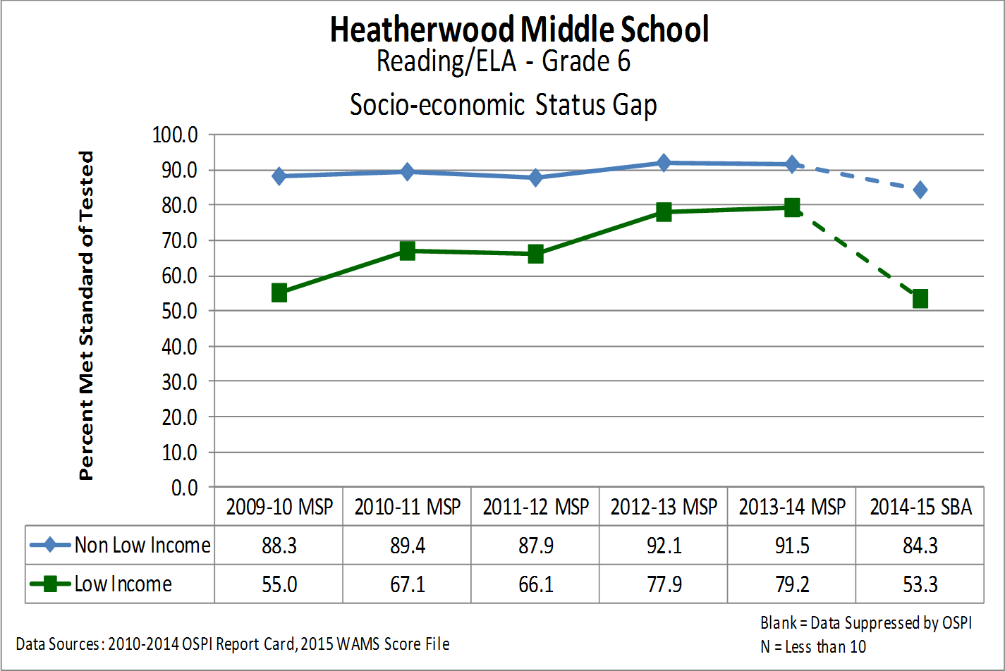
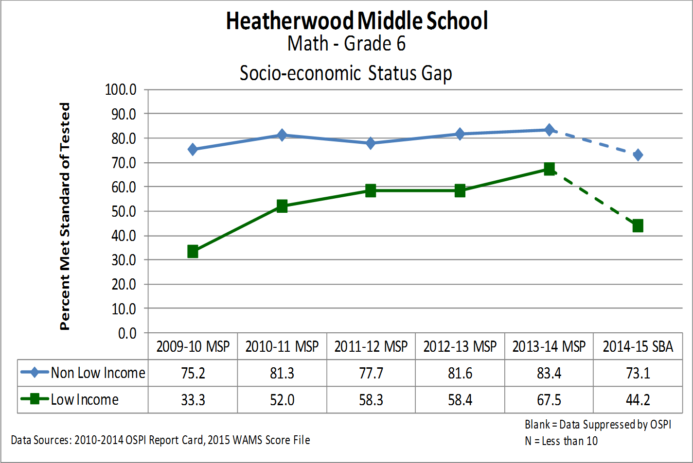
Grade 6 SES Achievement Gap
31 %
28.9%

Slide 18
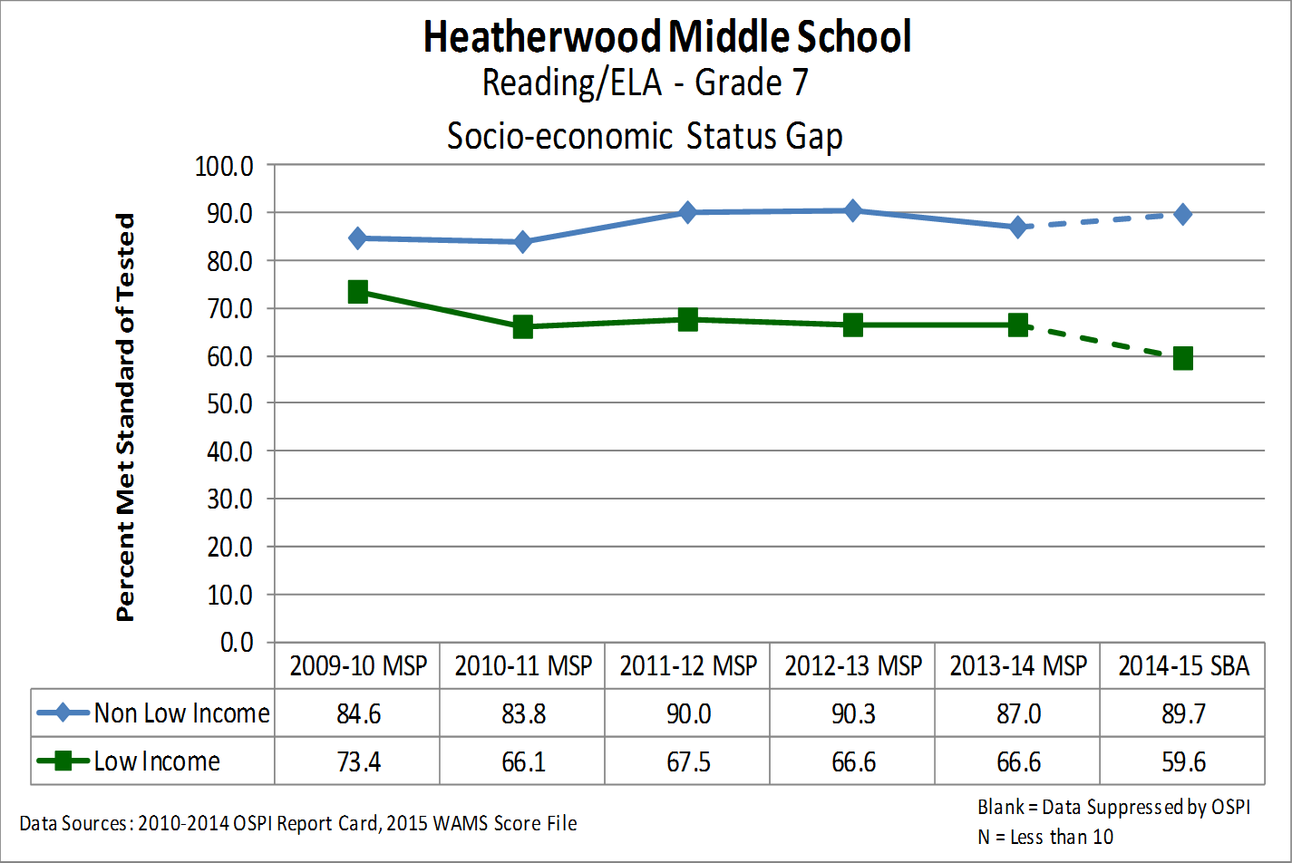
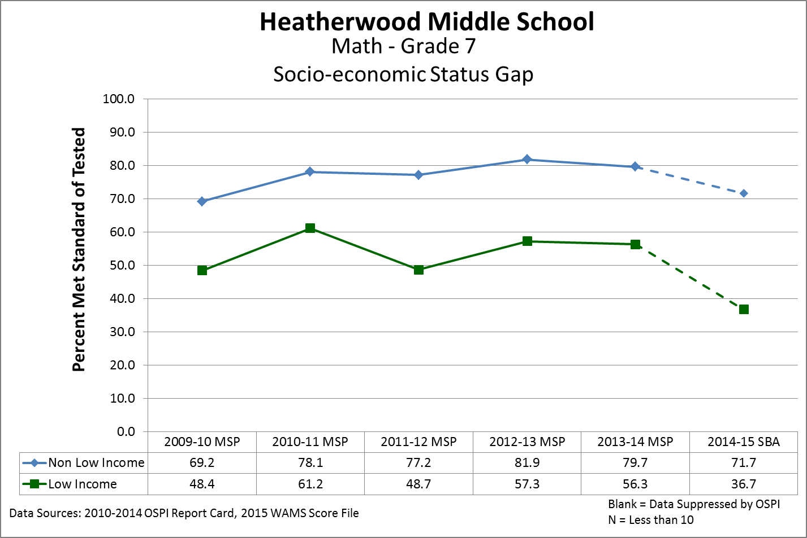
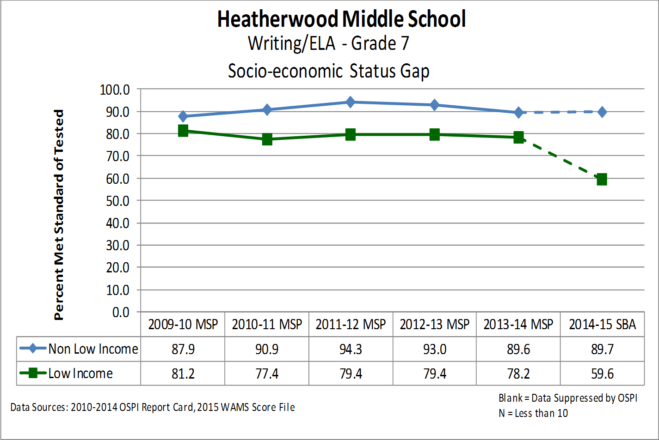
Grade 7 SES Achievement Gap
30.1%
35%
30.1%

Slide 19
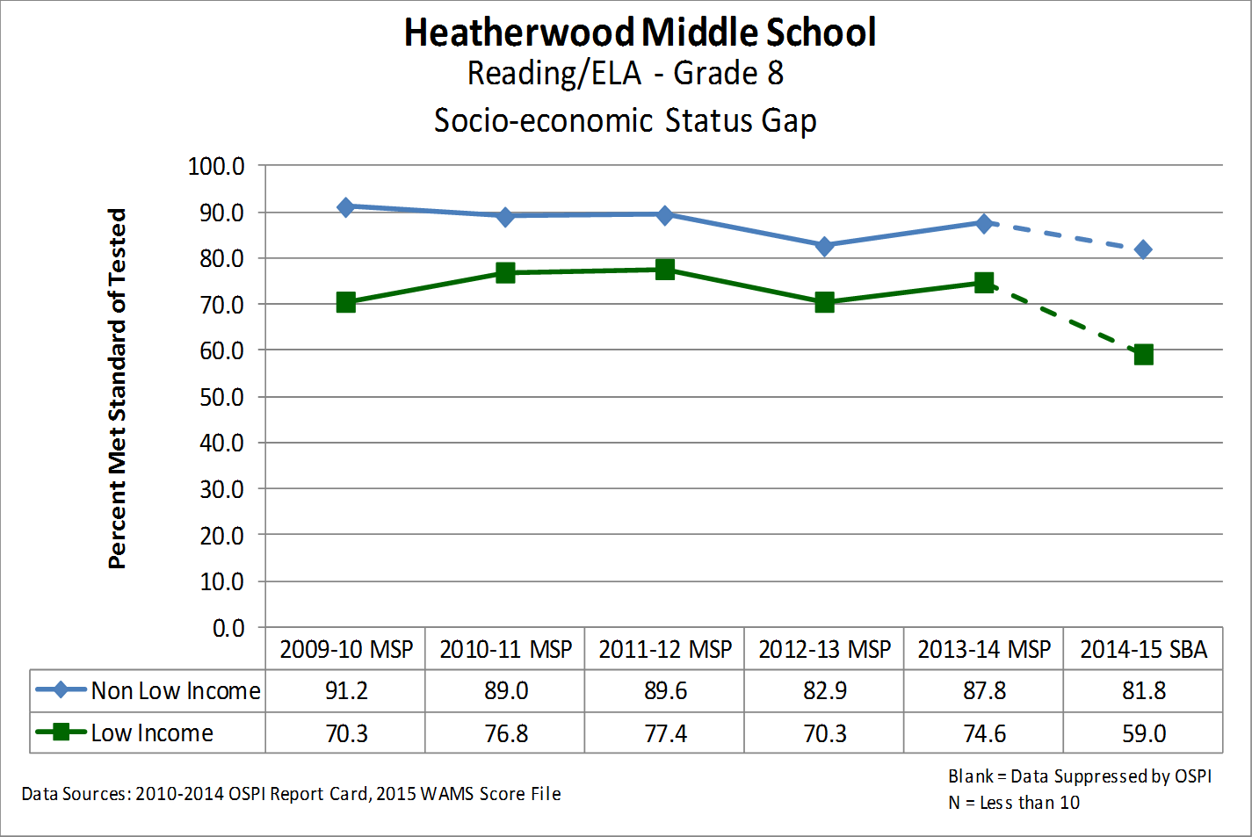
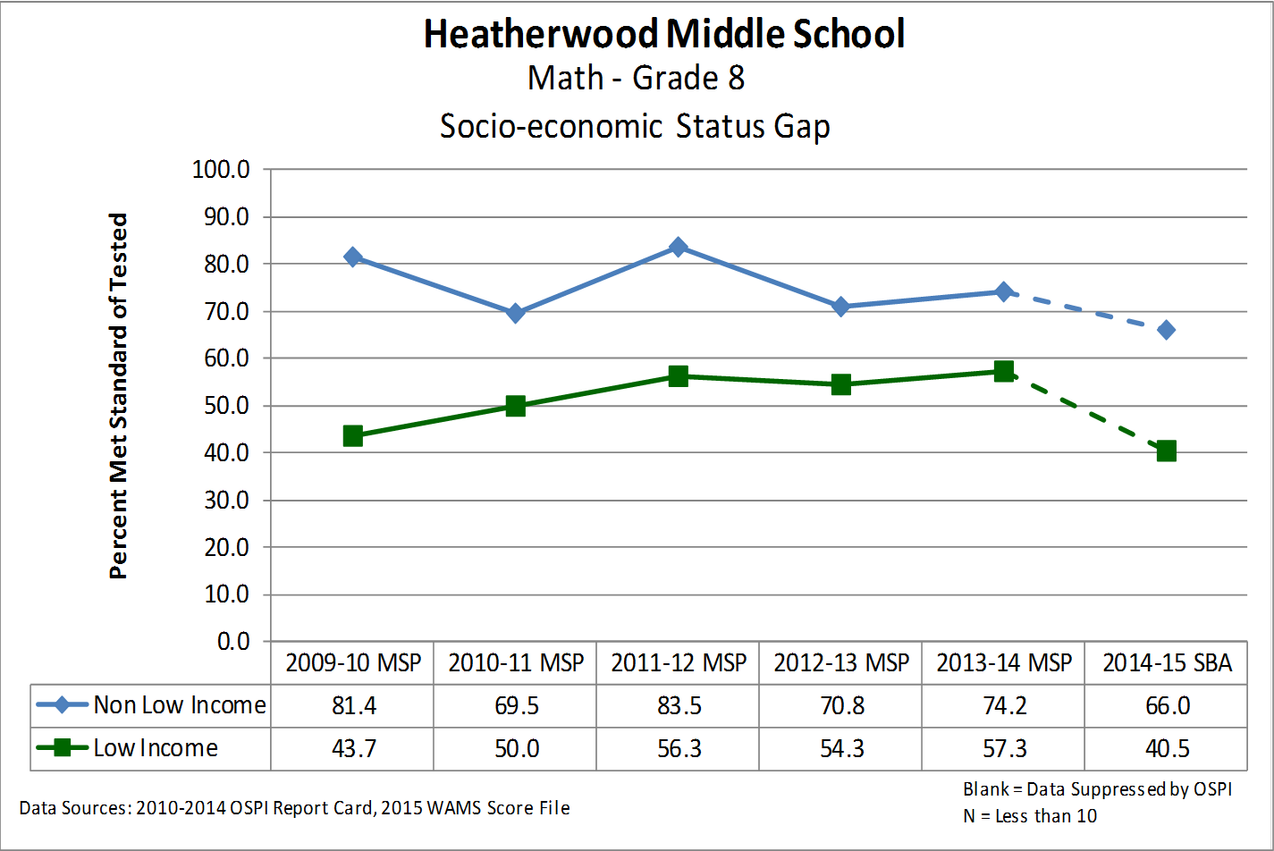
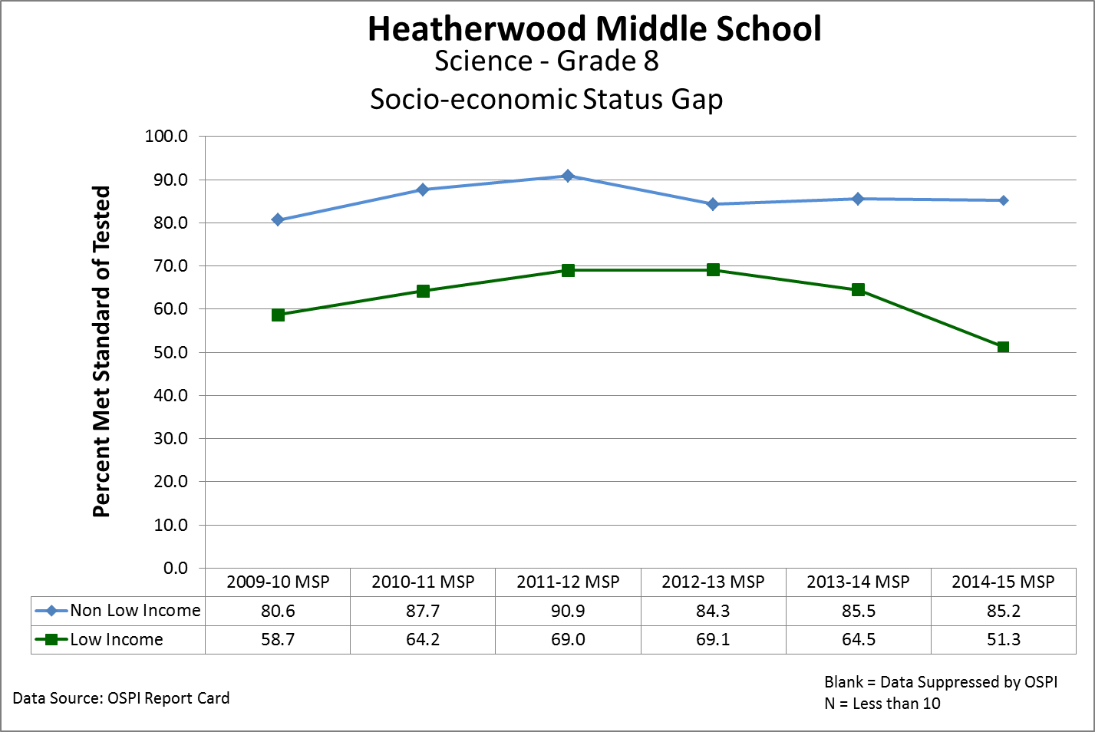
Grade 8 SES Achievement Gap
22.8%
25.5%
33.9%

Slide 20
English Language Acquisition
Annual Measurable Achievement Objectives for English Language Learners
The percentage on the AMAO-1 chart (above) represents the percent of students who grew at, or above, the expected number of points.
The percentage on the AMAO-2 chart (left) represents the percent of students who demonstrated English language proficiency by scoring a Level-4 on the WELPA assessment.
AMAO-1 and AMAO-2 charts require a minimum N of 10 students to display data.
2015-16:
67 Students (30 6th Graders)
42 Level 3
20 Level 2
5 Level 1

Slide 21
5-year Improvement Trend vs. 2015 Performance

Slide 22
EES Staff Perceptions – 2015

Slide 23
EES Staff Perceptions - Longitudinal

Slide 24
Resistance Factor, Change, Accountability

Slide 25
EES Student Perceptions - Longitudinal

Slide 26
EES Parent Perceptions - Longitudinal

Slide 27
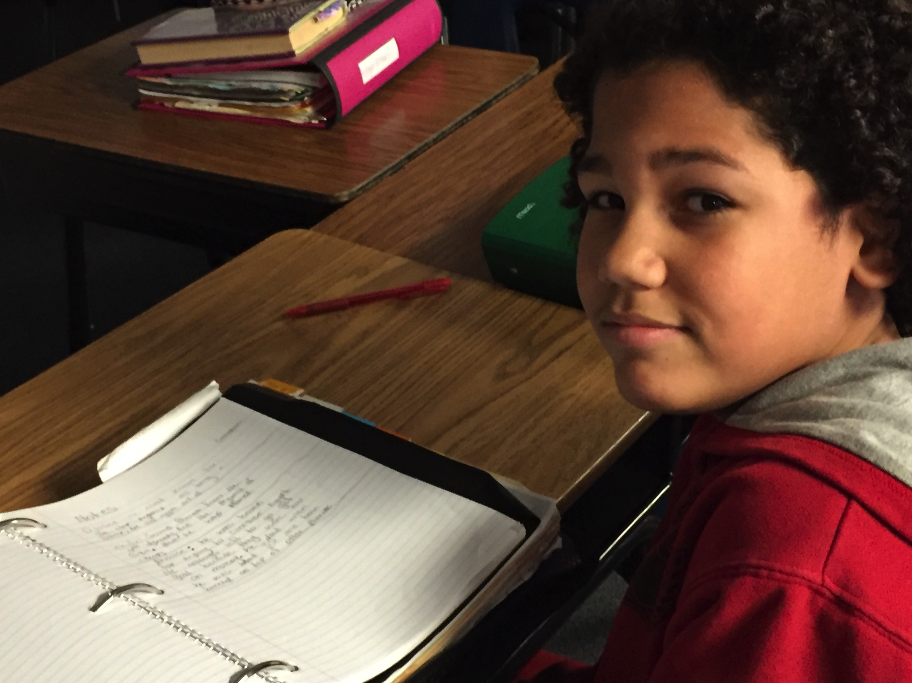
Opportunity

Slide 28
Addressing our Shift in Demographics in School Improvement Plan
Building-Wide Focus | High Performing Teams
Family Partnerships Equitable Access High School Readiness Challenging Options Welcoming Culture | Common Assessments Strategic supports based on data and student work Reading, Writing and Student Discourse across all Contents

Slide 29


Our Building Focus/Heatherwood Leadership Team
Addressing shifts in demographics
Establishing consistency around assessment and grading
Fostering innovation in staff and students
Staff:
  creating resiliency in how we think/how we teach/how we approach problems (“Hacks” as described by James Whitaker.)
Students:
  Learning opportunities that embrace rigor and relevance
  Fostering habits of learning that build resiliency

Slide 30
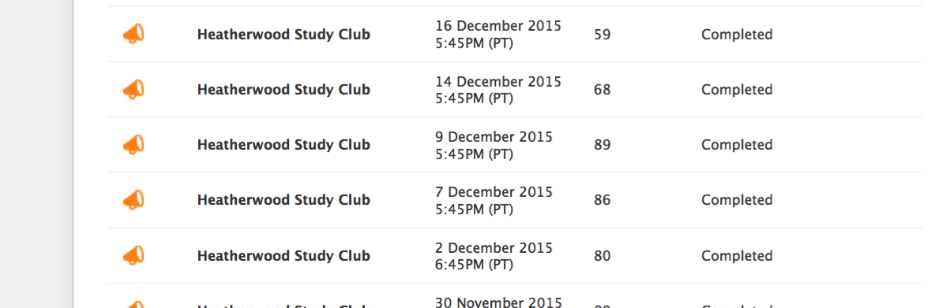
Family Partnerships: Implement systems for communication to Families
Weekly Newsletter via BlackBoard Connect from the principal:
Hello Heatherwood families,
Report Cards will be sent home with students this coming Friday, February 12th. Report cards will be distributed during 7th period. Please also support your student by checking grades online through the Grades & More link on the top right corner of Everett Public Schools website.
PTA Meeting: Our PTA has their monthly meeting on Monday evening at 7:00 PM. At 6:30 PM, PTA is hosting a second viewing of our S.O.S. curriculum (Signs of Suicide). We invite all parents to this viewing and also encourage parents to stay and learn more about PTA.
STEAM (Science, Technology, Engineering, Arts and Math) Assembly: Our fantastic Heatherwood PTA has arranged for all Heatherwood students to participate in an Music and Technology Assembly with composer/speaker, Brent Daniels. This is an interactive assembly tha
Study Club Support (two times a week) where teachers can sign students up
Teacher Assigned Study Club:

Slide 31
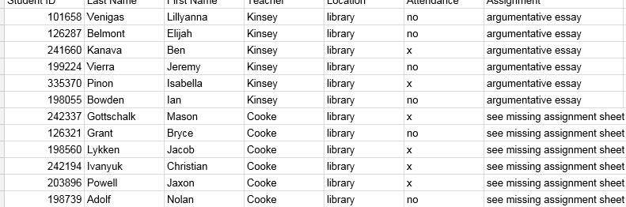
Equity and High School Readiness: Reduction of Ds & Fs
Support for under-performing students
Teacher Assigned Study Club
Two Science & Math Study Club Stipends
Re-allocation resources to provide Push-In/Pull Out supports

Slide 32
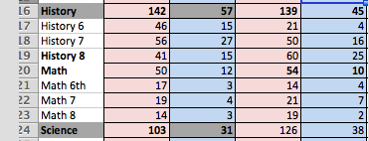

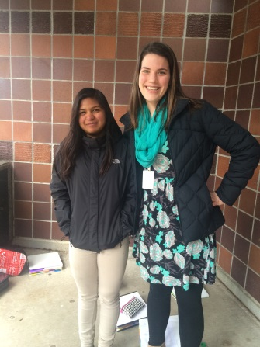
Equity and High School Readiness: Reduction of Ds & Fs
Focused support in Social Studies & Science as classes with high numbers of struggling students
Wrap-around supports in all classes

Slide 33
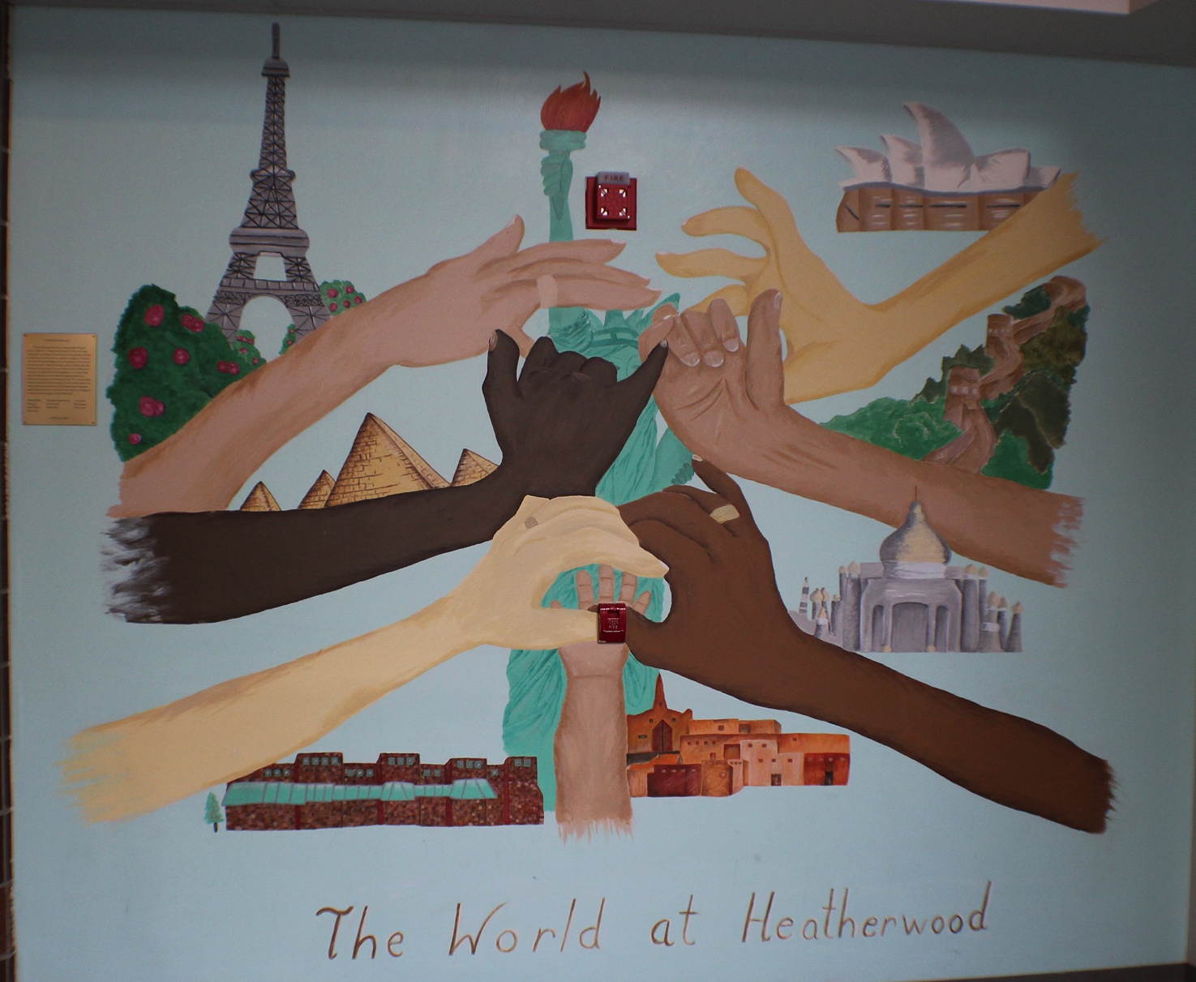
Equity and Challenging Options

Slide 34
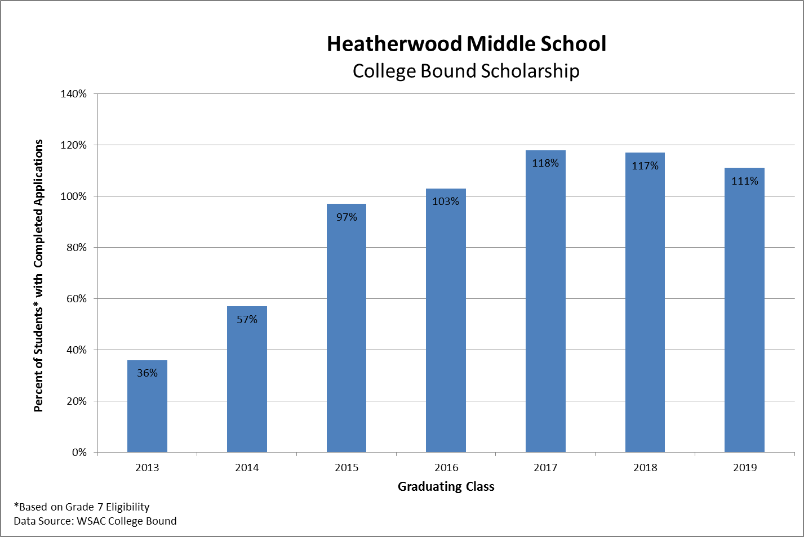
College Bound Scholarship

Slide 35
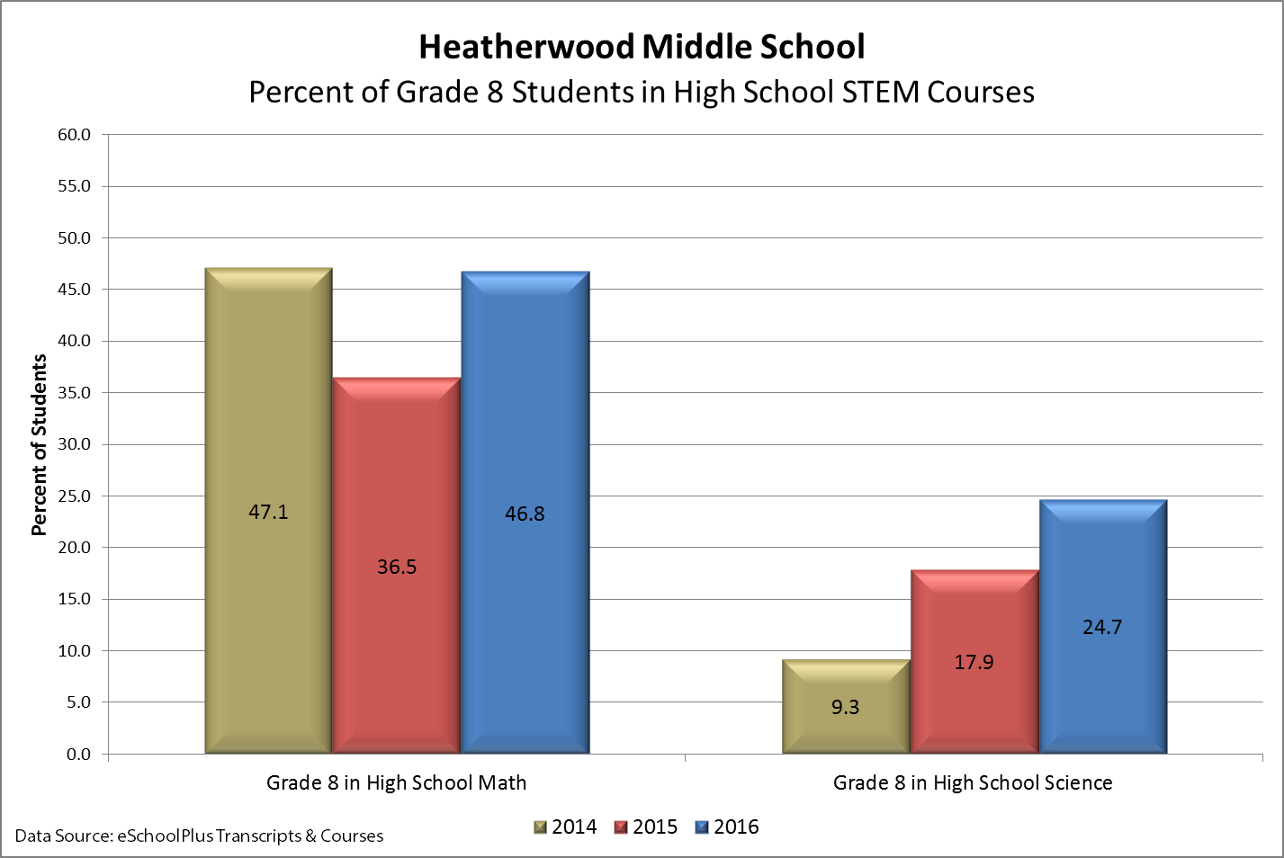
STEM Courses

Slide 36
Access to Advanced Classes 2014-15

Slide 37
Access to Advanced Classes 2015-16

Slide 38



Recruitment Actions
Identify kids in 7/8 Math for Coordinated Science
Identify kids who could “bump” into higher level English with support
Develop system to provide additional access points to advanced pathways (support needed)

Slide 39
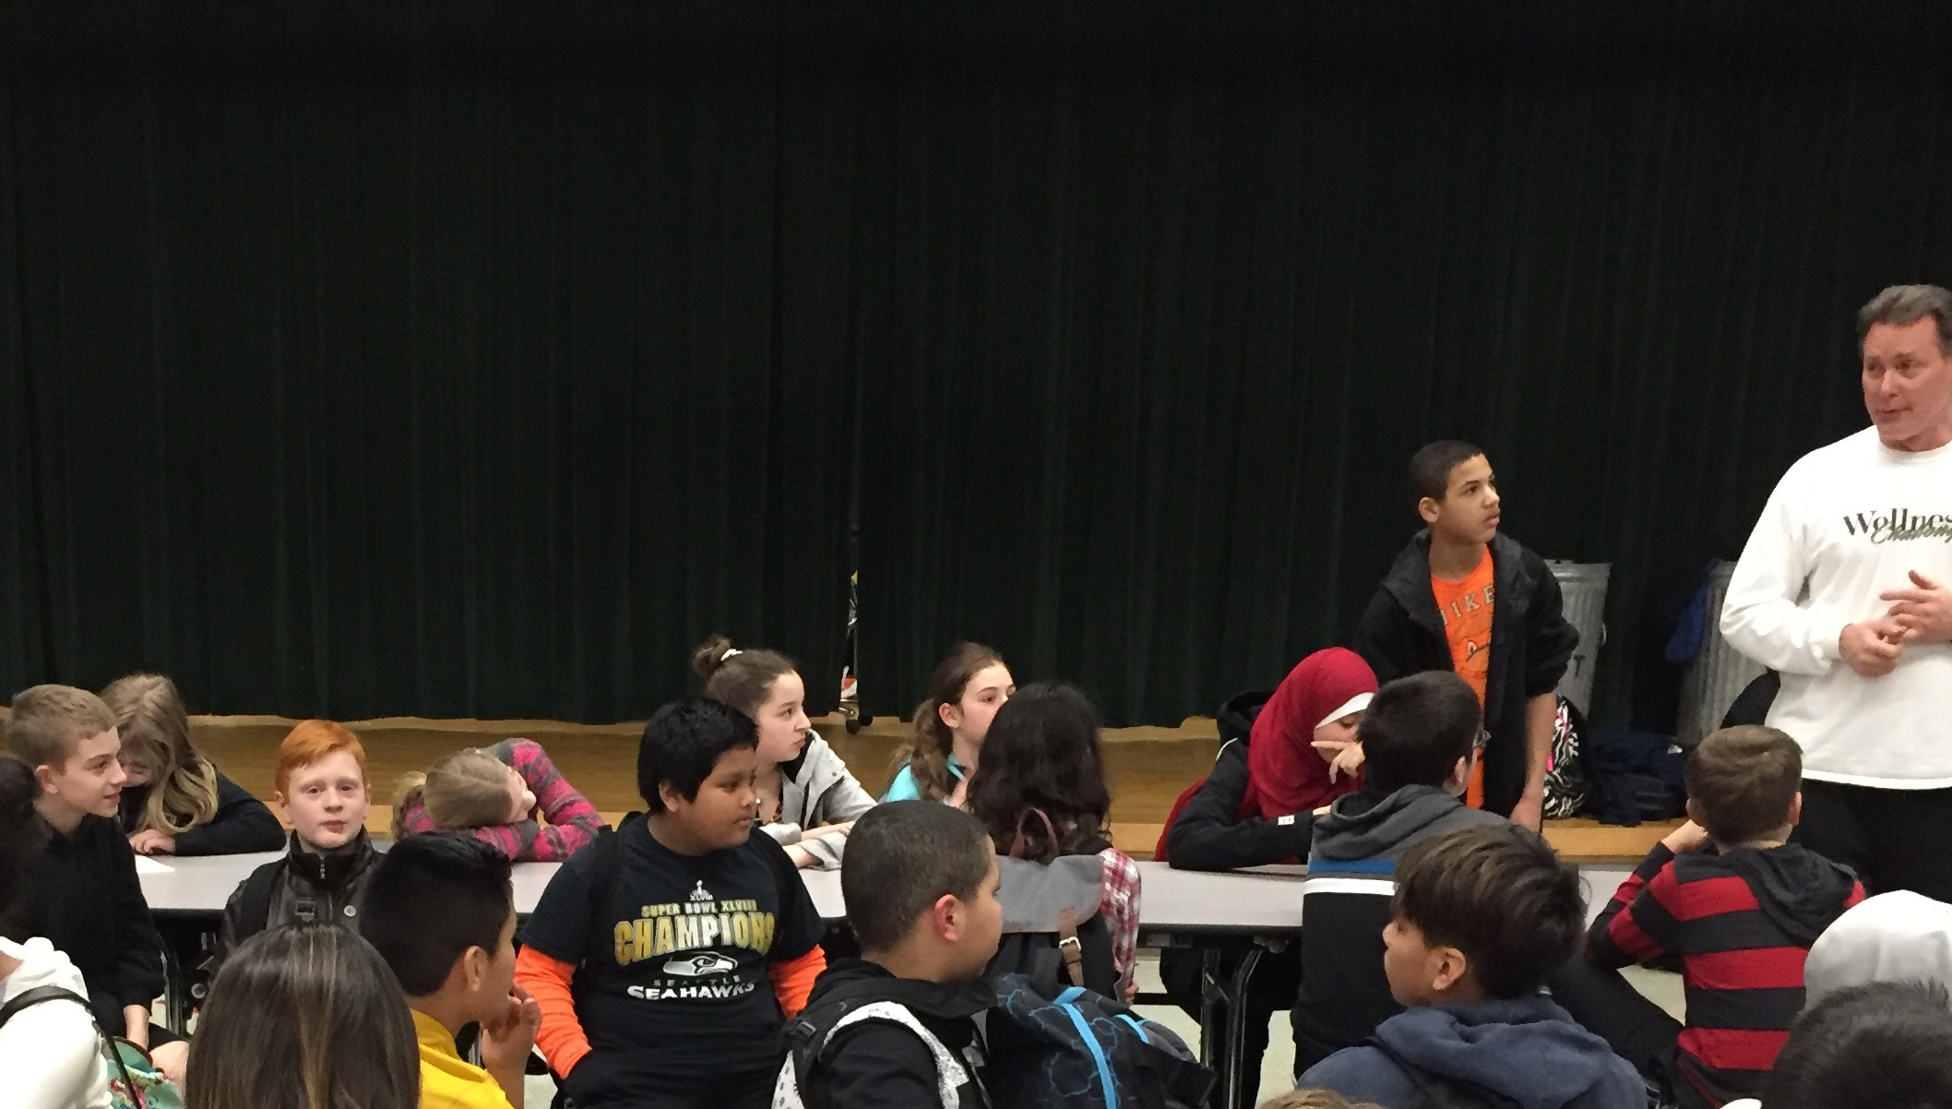
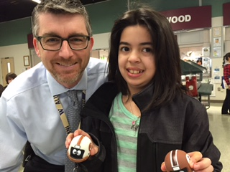
Welcoming Environment
School-wide positive approach to
discipline
  Partnering with staff and students
Create more opportunities for students

Slide 40
High Performing Teams
Collaborative goals centered on text-based writing across all three grade-levels and multiple contents:
  Science
  English
  Social Studies
Collaborative discourse around student work and assessment data
Systems for monitoring and support

Slide 41
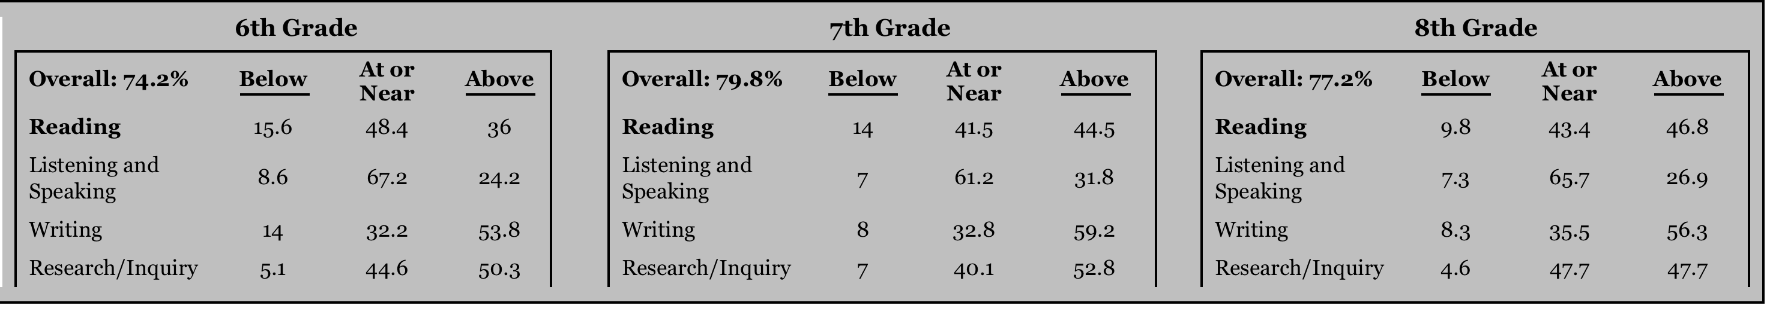
Key Performance Outcomes for English/Language Arts
The target for the 2015-2016 school year is 100% of students meeting standard on the Smarter Balanced Assessment (SBA) in English Language Arts (ELA).
25.8%
20.2%
22.8%

Slide 42
6th Grade ELA

Slide 43
7th Grade ELA

Slide 44
8th Grade ELA

Slide 45
ELA Gender All Grades

Slide 46
Reading & Writing Action Items
Ensure high volume of reading, writing and speaking across all contents
Provide opportunities for students to write and speak using evidence from the text (Reading Action)
Provide opportunities for students to write using text based evidence including well-defended claims, analysis and accurate summaries (Writing Action)
Provide opportunities for students to synthesize multiple sources by using note taking strategies and graphic organizers across all content areas

Slide 47
Key Performance Indicators
Increase circulation of titles based on Summer Reading, Battle of the Best-Sellers and Book Talks
Growth on embedded assessments in SpringBoard
Increase proficiency in supporting reasoning and analysis with text-based evidence in all content areas and across all grades

Slide 48
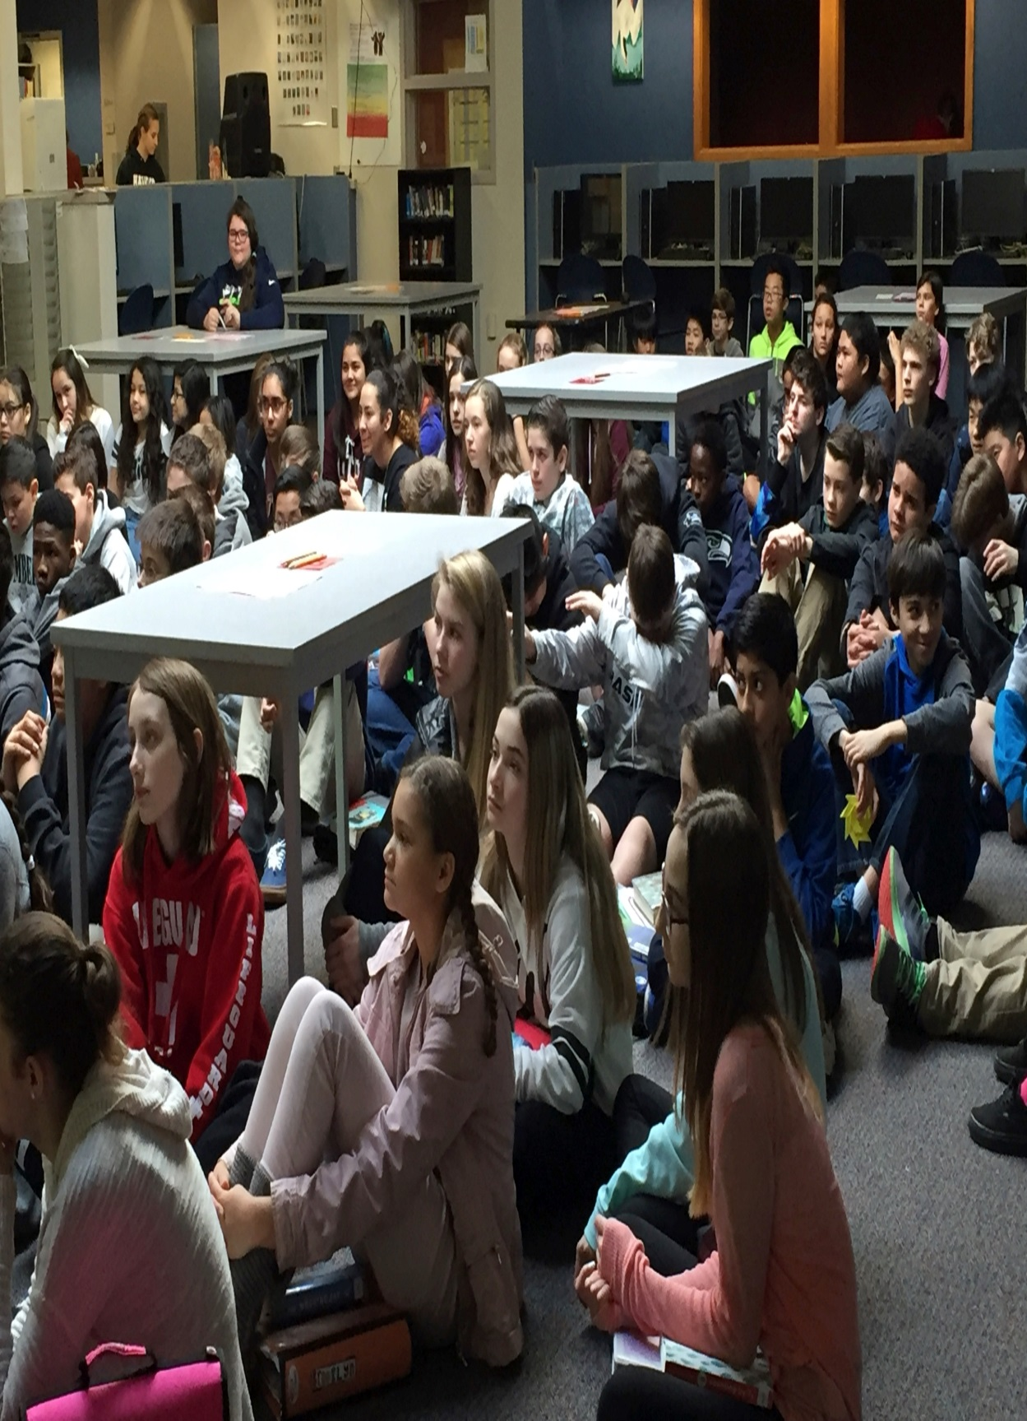
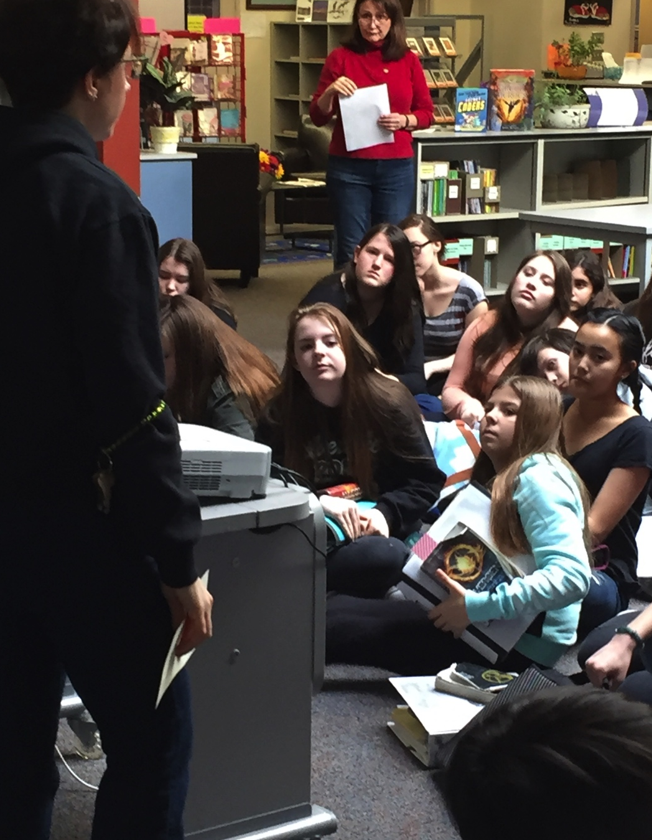
Battle of the Bestsellers—7th Grade

Slide 49
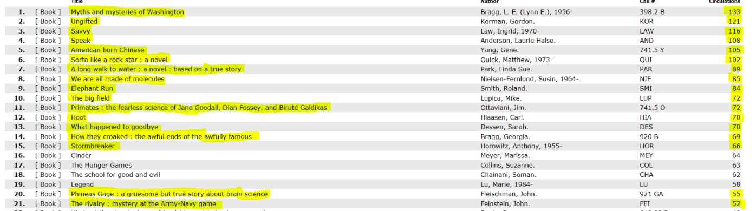
Action Item #1: Circulation Data showing High Volume of Reading
“Bottom line: promoting books in collaboration with teams, and having funds to purchase multiple copies of coveted titles COUNTS. Heatherwood Hawks READ!” Sara Herber, Librarian.
Myths and Mysteries of Washington
133

Slide 50
KPI #2: Growth on SpringBoard Embedded Assessments

Slide 51
Embedded Assessments: Approaching Standard
6th & 7th Collaboration and Scoring days

Slide 52
7th Grade Embedded Assessment
90% of students are proficient or exemplary in structure
87% of students are proficient/exemplary in ideas
74% of students are proficient/exemplary in use of language
Score | Ideas | Structure | Use of Language
4-Expemplary | 75 41% | 74 41% | 59 32%
3-Proficient | 82 46% | 89 49% | 76 42%
2-Emerging | 20 11% | 16 8% | 43 24%
1-Incomplete | 3 2% | 3 2% | 4 2%

Slide 53
Embedded Assessment Instructional Focus
Primary area of concern
    Conventions
      Consistent verb tense
      Dialogue
      Subject/verb agreement
      Pronouns and antecedents
      Sentence fluency/variety
    Figurative language/sensory details
      Show vs. tell

Slide 54
7th Grade English Next steps
With Students:
Share and score exemplar papers
Analyze and color code essays to identify structural requirements
Share Informative-Explanatory Performance Task Writing Rubric grades 6-11
Provide for students below proficiency:
  One-to-one conferences
  Small group instruction
As a Team:
Engage in another scoring/calibration day on March 3 with district facilitator Beth Shipe present to guide us

Slide 55
8th Grade English
Writing Conferences
Strategic support for Level 1 and Level 2 writers based on analysis of SpringBoard assessments.

Slide 56
Embedded Assessment Data – 8th Grade

Slide 57
Common Areas Identified for Intervention
IDEAS: Embedding Dialogue/Direct Quotations, Providing Evidence Relevant to Thesis, Providing Commentary to Explain Relevant Evidence.
STRUCTURE: Outlining an Essay, Organizing Support Paragraphs, Transitions.
USE OF LANGUAGE: Formal Language, Command of Standard Conventions.

Slide 58
Writing Conference Proposal
Objective: Provide one-on-one writing interventions for students (15-20 minutes per student), re-teach key skills, introduce strategies to help students improve writing.
Some Strategies Used:
Pre-Writing/Creating Outlines
Oral Reading of Essay
Sentence Structure Practice
TLQC Method – Embedding Quotations
Re-write of One Paragraph
Topic Sentences/Transitions
Sentence Stems for Embedding Quotations/Commentary
How to Properly Revise

Slide 59
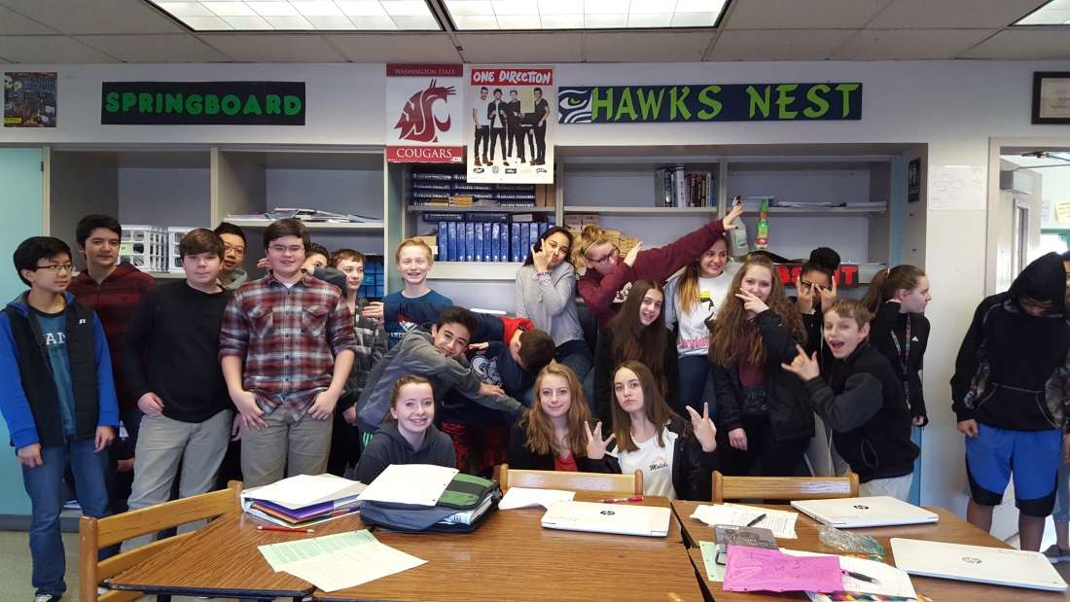

Impact of Writing Conferences
Engage Students in Dialogue About Their Own Writing
Allow Students to Express Concerns About Writing
Provide Students With Strategies to Improve
Instill Confidence
Let Students Know That Teachers Care and Are Willing to Work With Students

Slide 60
ELA Common Goal for Text-based evidence:
Writing and synthesizing using multiple sources
Increase proficiency in supporting reasoning and analysis with text-based evidence in all content areas and across all grades
Ability to correctly cite text
Ability to write commentary
  about the text
Ability to select relevant text

Slide 61
6th Grade ELA Honors Strategy for Citing Relevant Text-Evidence
Four Assessments
Baseline
Poetry Unit
Opinion Unit
Expository Unit

Slide 65
Level 4 – Crucial & Develops the Idea
Textual Evidence (precise and crucial cited evidence that clearly develops the idea) | Commentary – Interpret the cited quoted textual evidence and explain how it develops the idea.
In the 1st paragraph of Making Up New Measures, the passage quotes “Nike Fuel is a completely fabricated unit of measure that shows people how active they are during the day. Even as of this writing, we can find no corresponding unit of measure, it's just Nike's own unit that is measured the same across devices so you can compare it with your past activity and other's activity if they are on the Nike+ network.” | Therefore, Nike is using some made up numbers on social media and consumers are likely to buy it. This proves how naive the 21st century is, and so Nike can use that against these people. As concluded above, you can see how dedicated Nike is to using social media to lure in vulnerable customers. In addition, not only has this popular brand created more social media, but they also provide more access to their investments to fit a customer’s needs.
Level 3 – Supports the Idea
Textual Evidence (accurate and helpful cited evidence that supports the idea) | Commentary – Explain how the cited quoted textual evidence supports or clarifies the idea.
Based on the article by John Cashman, Nike is “killing it in social media.” The athletic apparel company is doing this by (stated in the 2nd paragraph in the section, Changing Goals) “Moving away from traditional advertising and focusing on digital marketing with a big investment in social media including Twitter and Facebook, and its own social media, Nike+.” | One way Nike is using this strategy to attract customers to use their products is with their recent product, Nike Fuel.
Survival of the Most Relevant Text
Level 2 – Relates to the Idea
Textual Evidence (evidence that is somewhat connected to the idea) | Commentary – Paraphrase the textual evidence or explain how it relates to the idea.
”their end goal is to make sure you buy their clothes rather than clothes from Under Armour or Adidas” | which is the end product of making you feel as if you are part of Nike.

Slide 66
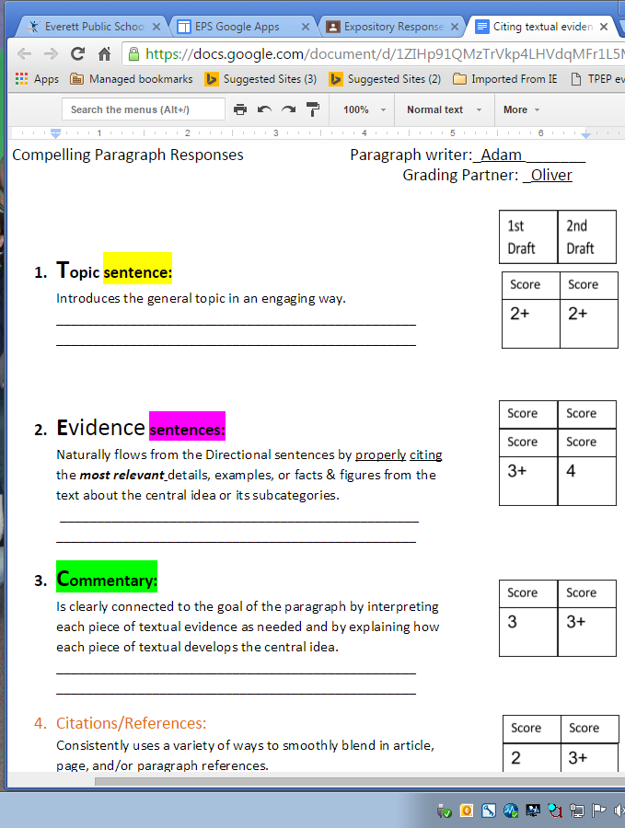
After scoring their first and second drafts with a partner on this document, students reflected on their process and established a goal for future text-based evidence responses experiences .
(as shown on the next document)

Slide 67
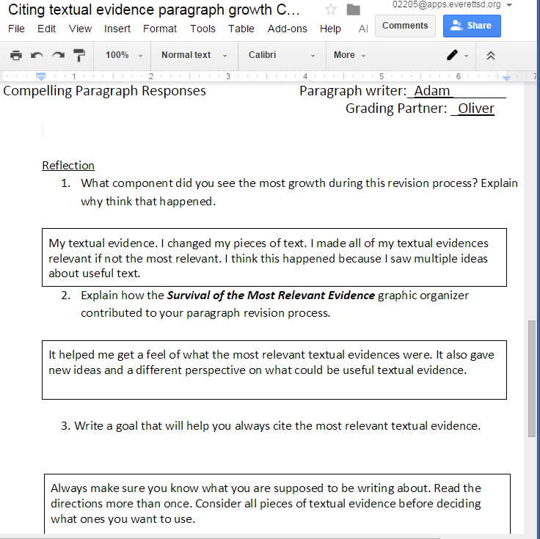
Next Step:
Turn goals into S.M.A.R.T. goals!

Slide 68
6th Grade ELA Honors Strategy for Citing Relevant Text-Evidence
Growth: Students’ poetry analysis post-assessment and argumentative essay post-assessment showed significant growth in students’ ability to support ideas with relevant textual evidence and provide meaningful commentary.
Unanticipated Results: By the time students completed their argumentative essay, their ability to effectively cite references dropped.
Commentary achievement dropped during the last expository assessment.

Slide 69
6th Grade ELA Honors Strategy for Citing Relevant Text-Evidence
Next Steps
Maintenance:
  Continue using Survival of the MOST relevant textual evidence graphic organizer
  Continue reviewing citation/reference format
Intervention:
  Focus on commentary by having students score sample responses’ commentaries and have them fix paragraphs with deficient commentaries.

Slide 70
6th Grade ELA Citing Text-Based
Evidence in Social Studies
Juli Taylor

Slide 71
6th Grade Text-Based Evidence Data from Team Goal

Slide 72
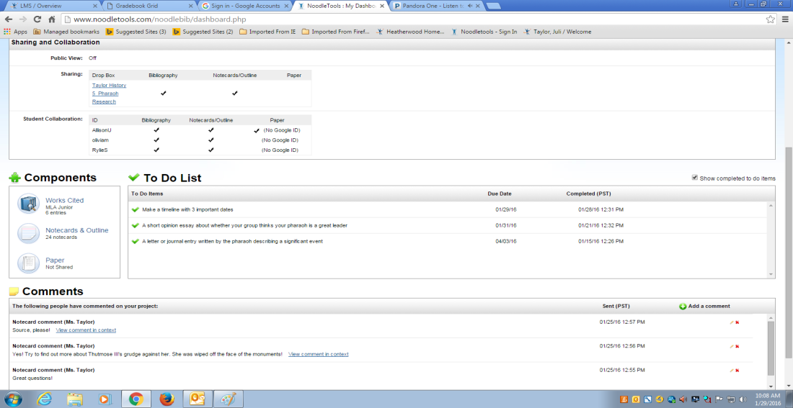


Citing Text-Based Evidence: 6th Grade Noodle Tools

Slide 73

Citing Text Based Evidence: 6th Grade Social Studies

Slide 74

Citing Text Based Evidence: 6th Grade Social Studies

Slide 75
Citing Text Based Evidence: 6th Grade Social Studies

Slide 76





Student Synthesis and Presentations

Slide 77
7th Grade Text-Based Evidence Pre-Assessment
Two Years of Data

Slide 78
7th Grade Text-Based Evidence
72% of our students are below standard on ability to cite text-based evidence
87% of our students are below standard on ability to provide commentary on evidence cited.
Action Plan
Nearing the end of instructional cycle
Scoring day with Beth Shipe, March 3rd
Continue to work with Social Studies

Slide 79

Feedback Cycle
Formative learning opportunities with feedback support students
Students need to know that you believe they can do it

Slide 80
8th Grade Text-Based Evidence
Pre-Assessment in October based on argumentative
  prompt
Strategies to Improve:
  Writing prompts in SpringBoard
  Selecting RELEVANT textual Evidence
Assessed again on Argumentative Essay
Score | English 8 Citing | English 1 Citing | English 8 Commentary | English 1 Commentary
4-Above Standard | 10% | 25.5% | 8% | 17.25%
3-At Standard | 27.5% | 51.7% | 17% | 32%
2-Approaching Standard | 48% | 21.3% | 51% | 38.25%
1-Below | 13.5% | 1.5% | 24% | 12.5%

Slide 81



Student Discourse and Notetaking
Costa’s Levels, Cornell Notes & Marking the Text to prepare for Socratic Seminar

Slide 82

Implications for SBA
Collaborative work around citing text-based evidence will support Reading Claims and Writing Claims
Interim assessment will be given during the first half of March
Battle of Bestsellers and focused book talks
SpringBoard, current-events, and independent reading

Slide 83
Key Performance Outcomes for Math
The target for the 2015-2016 school year is 100% of students meeting standard on the Smarter Balanced Assessment (SBA) in Mathematics.
36.3 %
39.5 %
39.8 %

Slide 84
6th Grade MATH

Slide 85
7th Grade MATH

Slide 86
8th Grade MATH

Slide 87
MATH Gender All Grades

Slide 88
Math Action Items
Implement tasks that promote reasoning and problem solving
Elicit and use evidence of student thinking to assess progress towards mastery

Slide 89
Key Performance Indicator
Increase success on interim and common assessments
  and class observational data
Between October and May, students will gain proficiency in solving equations per grade level Common Core Standards. Students will be expected to gain at least one proficiency level from the pre to the post test.

Slide 90
Math Unit Assessment: Grade 6
Notes:
6/5% met standard on pre-test to 90.6% at or above

Slide 91
Math Unit Assessment: Grade 7
Notes:
8.6% met standard on pre-test to 55.8% met or above standard

Slide 92
Math Unit Assessment: Compacted 7/8
Notes:
0% met standard to 36% at or above standard (does not include retakes, which are pending)

Slide 93
Math Unit Assessment: Algebra
Notes:
0% met standard on pretest to 87.1% meeting standard or above

Slide 94
Action Item #1: Promoting Reasoning
Growth Mindset
Team Collaboration in lesson design
Student reasoning and justification

Slide 95


Action Item #2: Solving Equations
Daily Formative Assessments
“Reteach, Reteach, Reteach”
“Focus on Student Mastery”

Slide 96

Implications
Real-world context
Reasoning Skills
Multiple tools and strategies to ensure success

Slide 97

Key Performance Outcomes for Science
The target for the 2015-2016 school year is 100% of students in the 8th grade meeting standard on the MSP in Science.
22.5 %

Slide 98
8th Grade SCIENCE

Slide 99
8th Grade SCIENCE

Slide 100
Science Action Items
Implement communication strategy that articulates the claim, evidence and reasoning
Continued implementation of strategies for comprehension and analysis (e.g. Cornell Notes, Marking the Text, Interactive Notebooks, Close Reading, Quickwrites, Think, Pair and Share and Fishbowl)

Slide 101
Key Performance Indicator
By the spring of 2016, the majority of 6th -8th grade students will increase at least one level of proficiency in scientific argumentation and explanation through focusing on NGSS practices of scientific writing by making a claim, providing supporting evidence and connecting evidence to scientific reasoning as measured by in class assessments
Increase student articulation of science concepts and vocabulary in student writing and speaking

Slide 102
Claim, Evidence & Reasoning

Slide 103
8th Grade Stranded Percent Below

Slide 104



Action Item #1: Implement communication strategy that articulates the claim, evidence and reasoning
Staff Collaboration:
Learning Improvement Fridays
Curriculum guide for all grades
Student Communication:
Unpacking the rubric
Student discourse
Graphic organizers

Slide 105




Action Item #1: Implement communication strategy that articulates the claim, evidence and reasoning

Slide 106


Science Action Item #2: Continued implementation of strategies for comprehension and analysis (e.g. Cornell Notes, Marking the Text, Interactive Notebooks, Close Reading, Quickwrites, Think, Pair and Share and Fishbowl)

Slide 107
Collaborative Impact on Student Learning
Claim, Evidence & Reasoning measured at all three grades.
Collaborative inquiry about instruction and support for students
Student articulation of explaining and evaluating scientific concepts
  Scientific principles
  Scientific vocabulary
Increase emphasis on writing and increased rigor
  Consistent to Math, English Language in written explanations

Slide 108


Authentic Project-Based Learning
“Start with a problem that is authentic in the world
and that students want to solve.” Jane Chadsey, Educurious

Slide 109


Environmental Collage Project
Researched environmental issue
Analyzed the environmental problem and solutions
Communicated a message in a visual way
Environmental Issues
Population Growth
Global Warming
Deforestation
Over fishing
Ozone Layer Depletion
Ocean Acidification
Loss of Biodiversity
Lack of Water
Pollution

Slide 110



Collaboratively made the paper for the collage

Slide 111

Artist Statement
My art, “Tearing the Earth Apart,” is a metaphorical representation of how large, coal-spewing factories are ripping the earth to shreds. I show the factory erupting with smoke that dirties the sky, and in the choking smog are pieces, torn from the trees in the background. This represents how if factories don’t stop releasing harmful chemicals into the air, nature might be completely torn apart. I try to show that the only way to stop this collateral damage in its tracks is to shut down factories like the one pictured, to stop pollution for good.
Emmaline Shimmel
Solicited an emotional response in the viewer (Artists Statement)
Revised artist statements, evaluated their own work and that of a peer

Slide 112

“Using Writing, Science and Art to engage in problem solving and collaboration to promote global citizenship”

Slide 113

Thank You!
8 Hours of Security
Collaboration for calibration & scoring of common assessments
Investment in STEM
  Computers for Robotics
  PD for Project Based Learning for Math
  Expanded offerings for STEM courses
Literacy Support (Summer Reading program)

Slide 114
Supports
Professional Development Support: (Criteria 5)
Continue support for collaboration
Continued PD in areas of working with diverse learners and grading practices
Equity and Access for Students: (Criteria 8)
Multiple points of entry into Challenging Pathways and supports
Opportunities for all to earn high school credit
Support for after school programs to engage students academically
Facilities & Maintenance Review: (Criteria 2 & 6)
Security concerns with front entry and stairs
Office and classroom spaces need to be repurposed

